Slide 1
Data Link Control
By dr. R. K. Ojha
Lecture-22-25
( Chapter 11 )

Slide 2
Topics to be discussed
Framing
Byte stuffing & Bit stuffing
Flow Control
Error Control
Simplest Protocol
Stop-and-Wait Protocol
Stop-and-Wait Automatic Repeat Request
Go-Back-N Automatic Repeat Request
Selective Repeat Automatic Repeat Request
HDLC
PPP

Slide 3
FRAMING
The data link layer needs to pack bits into frames, so that each frame is distinguishable from another.
Our postal system practices a type of framing.
The simple act of inserting a letter into an envelope separates one piece of information from another; the envelope serves as the delimiter.

Slide 4
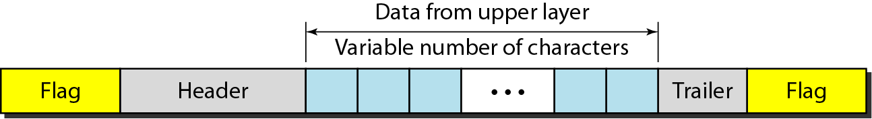
Figure 11.1 A frame in a character-oriented protocol
In character-oriented (or byte-oriented) framing, data to be carried are 8-bit characters from a coding system such as ASCII.
The header, which carries the source and destination addresses and other control information, and the trailer, which carries error detection redundant bits, are multiples of 8 bits.
To separate one frame from the next, an 8-bit (1-byte) flag is added at the beginning and the end of a frame.
The flag, composed of protocol-dependent special characters, signals the start or end of a frame.

Slide 5
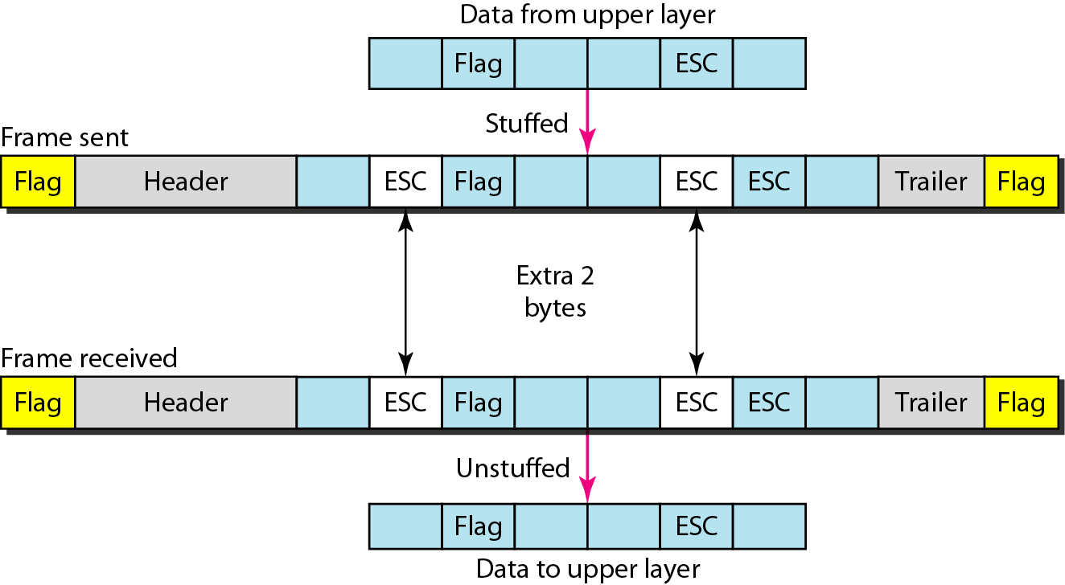
Figure 11.2 Byte stuffing and unstuffing

Slide 6
Byte stuffing and unstuffing
In byte stuffing (or character stuffing), a special byte is added to the data section of the frame when there is a character with the same pattern as the flag.
The data section is stuffed with an extra byte.
This byte is usually called the escape character (ESC) and has a predefined bit pattern.
Whenever the receiver encounters the ESC character, it removes it from the data section and treats the next character as data, not as a delimiting flag. Figure 11.2 shows the situation.
Demerits:
a) Presence of Multiple Escape sequences
b) Unicode characters

Slide 7
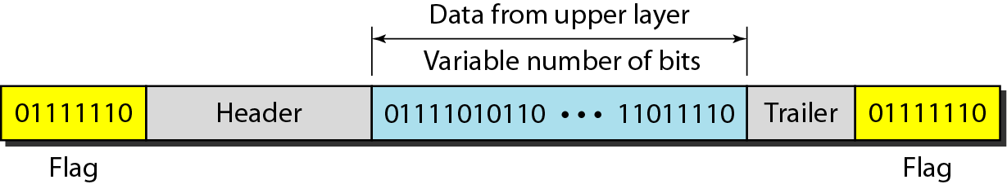
Figure 11.3 A frame in a bit-oriented protocol
In bit-oriented framing, the data section of a frame is a sequence of bits to be interpreted by the upper layer as text, graphic, audio, video, and so on.
Most protocols use a special 8-bit pattern flag, 01111110, as the delimiter to define the beginning and the end of the frame, as shown in Figure.
Here we do bit stuffing to avoid the same problem, if a 0 and five consecutive 1 bits are encountered, an extra 0 is added. This extra stuffed bit is eventually removed from the data by the receiver.
Note that the extra bit is added after one 0 followed by five 1s regardless of the value of the next bit.
This guarantees that the flag field sequence does not inadvertently appear in the frame.

Slide 8

Note
Bit stuffing is the process of adding one extra 0 whenever five consecutive 1s follow a 0 in the data, so that the receiver does not mistake the pattern 0111110 for a flag.
Figure 11.4 shows bit stuffing at the sender and bit removal at the receiver.
Note that even if we have a 0 after five 1s, we still stuff a 0.
The 0 will be removed by the receiver.
This means that if the flaglike pattern 01111110 appears in the data, it will change to 011111010 (stuffed) and is not mistaken for a flag by the receiver.
The real flag 01111110 is not stuffed by the sender and is recognized by the receiver.

Slide 9
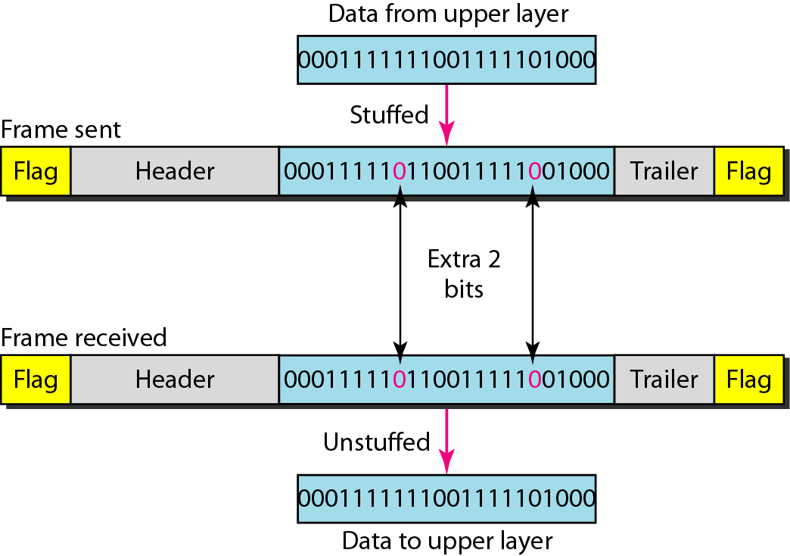
Figure 11.4 Bit stuffing and unstuffing

Slide 10
FLOW AND ERROR CONTROL
The most important responsibilities of the data link layer are flow control and error control. Collectively, these functions are known as data link control.

Slide 11
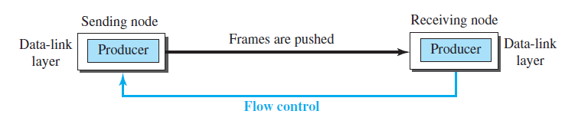
Note
Flow control refers to a set of procedures used to restrict the amount of data
that the sender can send before
waiting for acknowledgment.

Slide 12
Note
Error control in the data link layer is based on automatic repeat request, which is the retransmission of data.

Slide 13
PROTOCOLS
Now let us see how the data link layer can combine framing, flow control, and error control to achieve the delivery of data from one node to another.
The protocols are normally implemented in software by using one of the common programming languages.

Slide 14
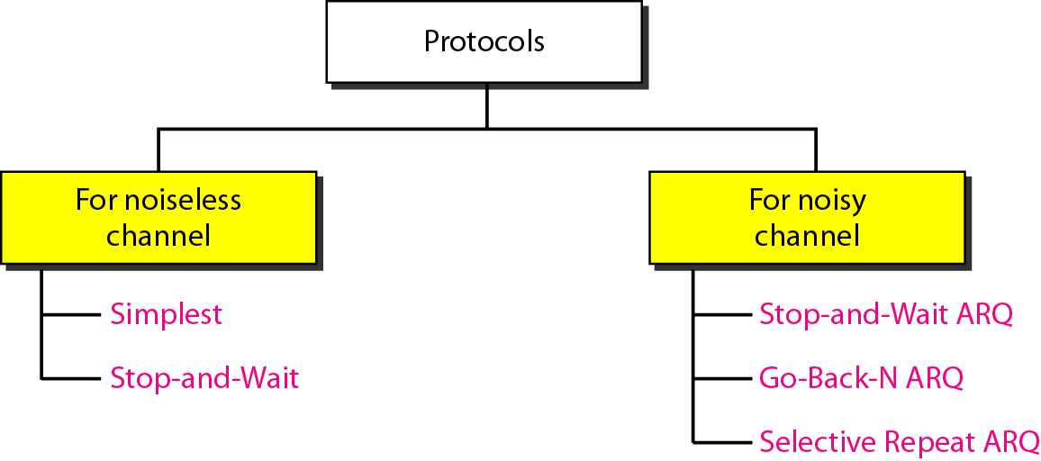
Figure 11.5 Taxonomy of protocols discussed in this chapter

Slide 15
NOISELESS CHANNELS
Let us first assume we have an ideal channel in which no frames are lost, duplicated, or corrupted.
We introduce two protocols for this type of channel.

Slide 16
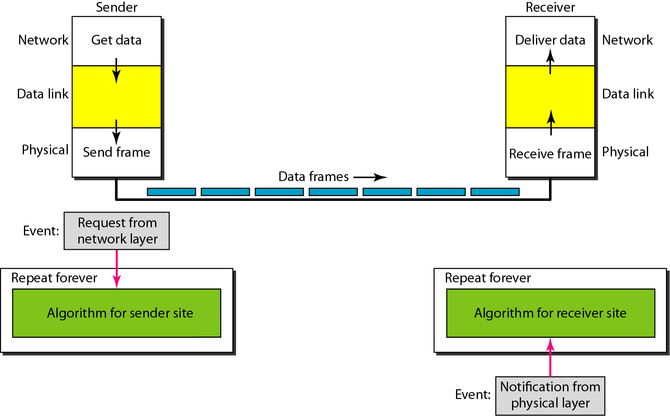
Figure 11.6 The design of the simplest protocol with no flow or error control

Slide 17
Algorithm 11.1 Sender-site algorithm for the simplest protocol

Slide 18
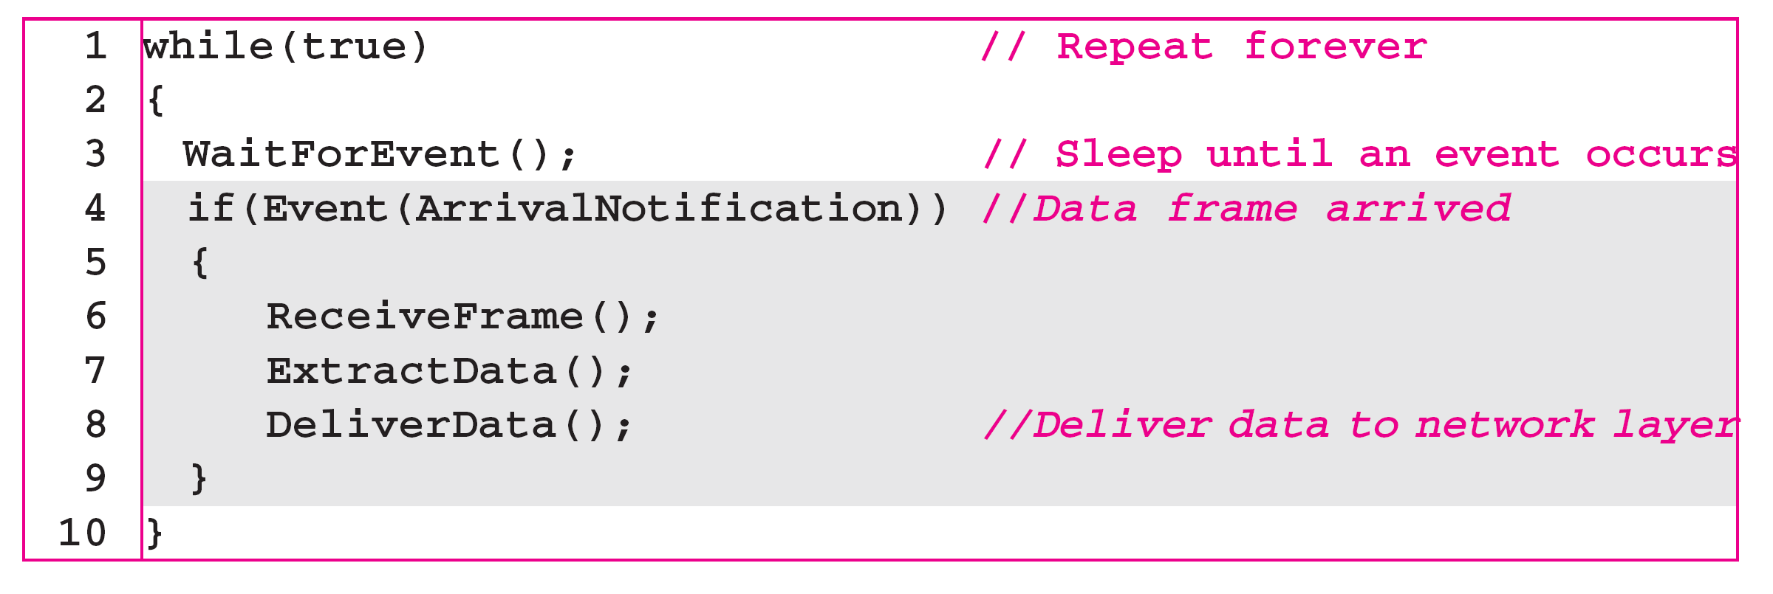
Algorithm 11.2 Receiver-site algorithm for the simplest protocol

Slide 19
Example 11.1
Figure 11.7 shows an example of communication using this protocol. It is very simple.
The sender sends a sequence of frames without even thinking about the receiver.
To send three frames, three events occur at the sender site and three events at the receiver site.
Note that the data frames are shown by tilted boxes; the height of the box defines the transmission time difference between the first bit and the last bit in the frame.

Slide 20
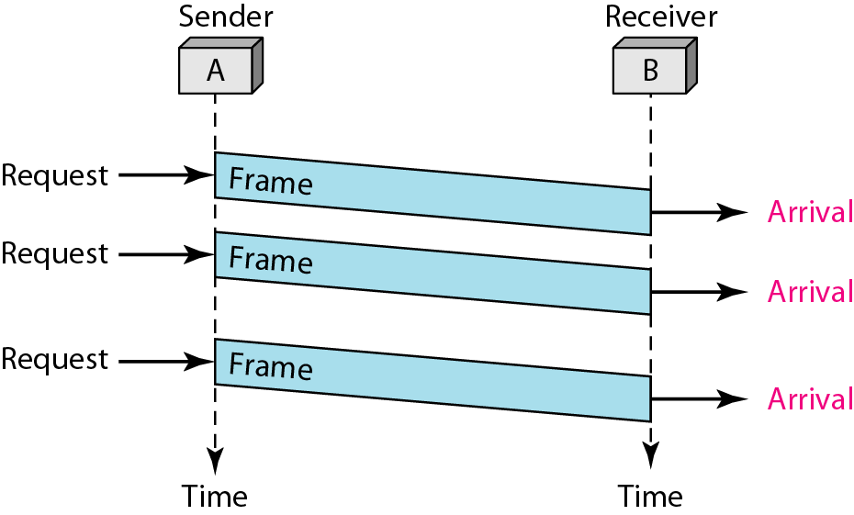
Figure 11.7 Flow diagram for Example 11.1

Slide 21
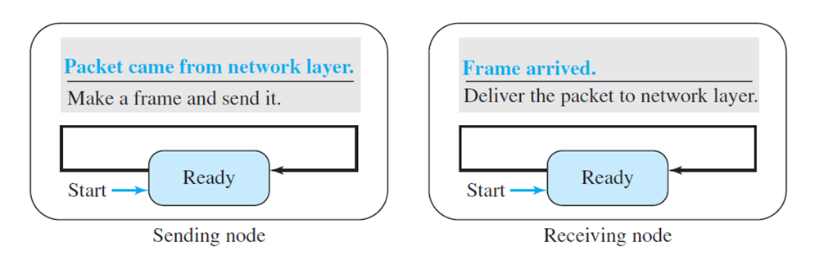
FSMs for the simple protocol

Slide 22
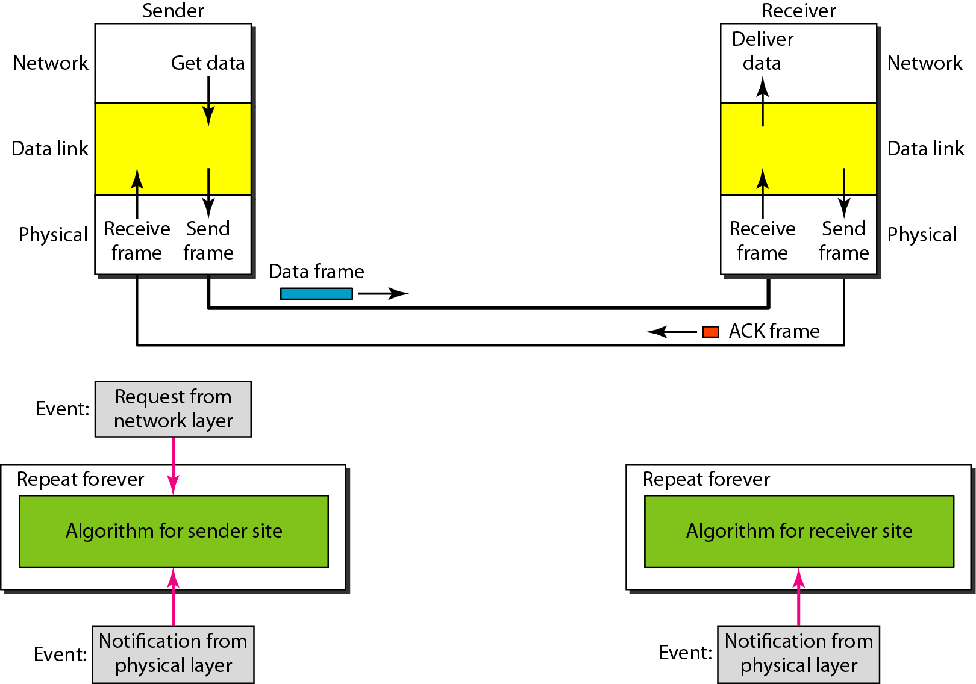
Figure 11.8 Design of Stop-and-Wait Protocol

Slide 23
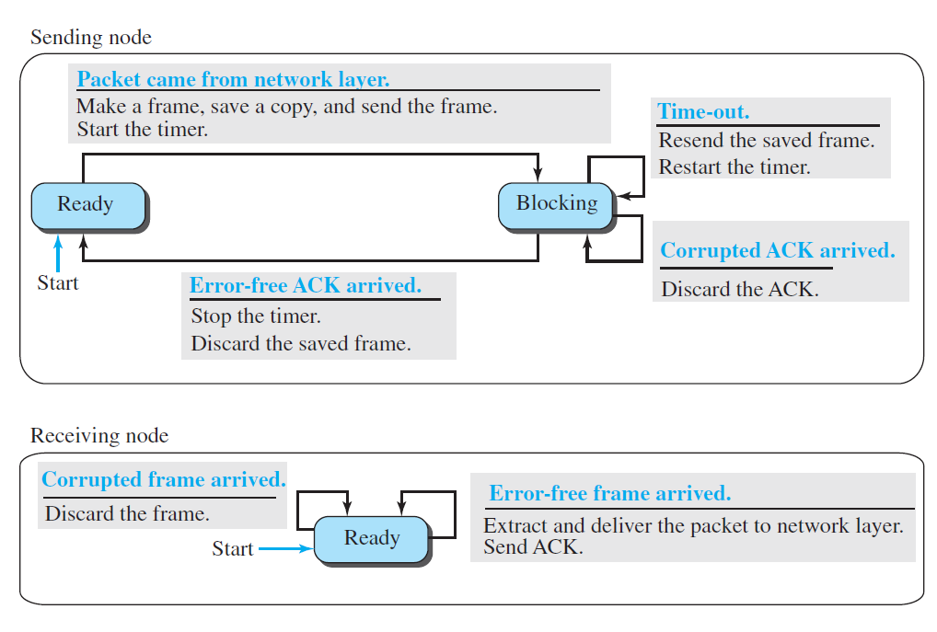
FSM for the Stop and wait protocol

Slide 24
Sender States
The sender is initially in the ready state, but it can move between the ready and blocking
state.
❑ Ready State. When the sender is in this state, it is only waiting for a packet from the network layer. If a packet comes from the network layer, the sender creates a frame, saves a copy of the frame, starts the only timer and sends the frame. The sender then moves to the blocking state.
❑ Blocking State. When the sender is in this state, three events can occur:
a. If a time-out occurs, the sender resends the saved copy of the frame and restarts the timer.
b. If a corrupted ACK arrives, it is discarded.
c. If an error-free ACK arrives, the sender stops the timer and discards the saved copy of the frame. It then moves to the ready state.
Receiver States
The receiver is always in the ready state. Two events may occur:
a. If an error-free frame arrives, the message in the frame is delivered to the network layer and an ACK is sent.
b. If a corrupted frame arrives, the frame is discarded.

Slide 25
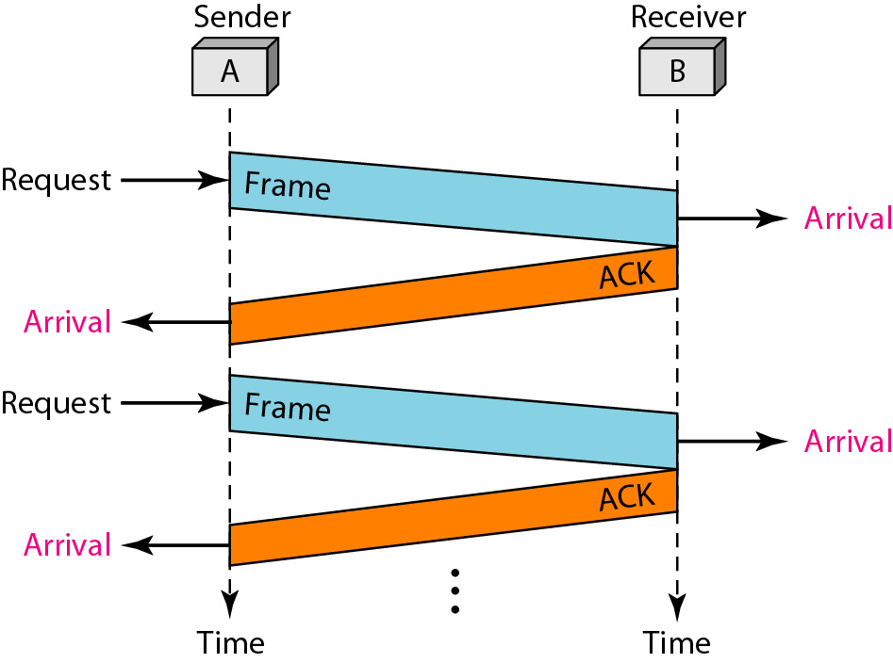
Figure 11.9 Flow diagram for Example 11.2

Slide 26
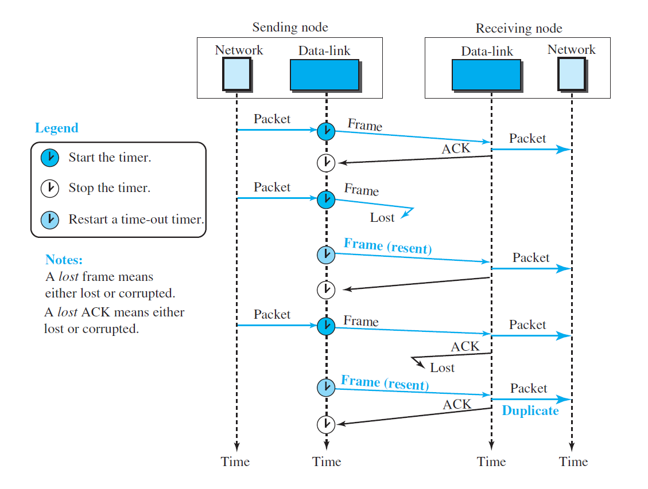
Figure 11.12

Slide 27
Example 11.3
Figure 11.12 shows an example. The first frame is sent and acknowledged. The second frame is sent, but lost. After time-out, it is resent. The third frame is sent and acknowledged, but the acknowledgment is lost. The frame is resent. However, there is a problem with this scheme. The network layer at the receiver site receives two copies of the third packet, which is not right. In the next section, we will see how we can correct this problem using sequence numbers and acknowledgment numbers.
Example 11.4
Figure 11.13 shows how adding sequence numbers and acknowledgment numbers can prevent duplicates. The first frame is sent and acknowledged. The second frame is sent, but lost. After time-out, it is resent. The third frame is sent and acknowledged, but the acknowledgment is lost. The frame is resent.

Slide 28
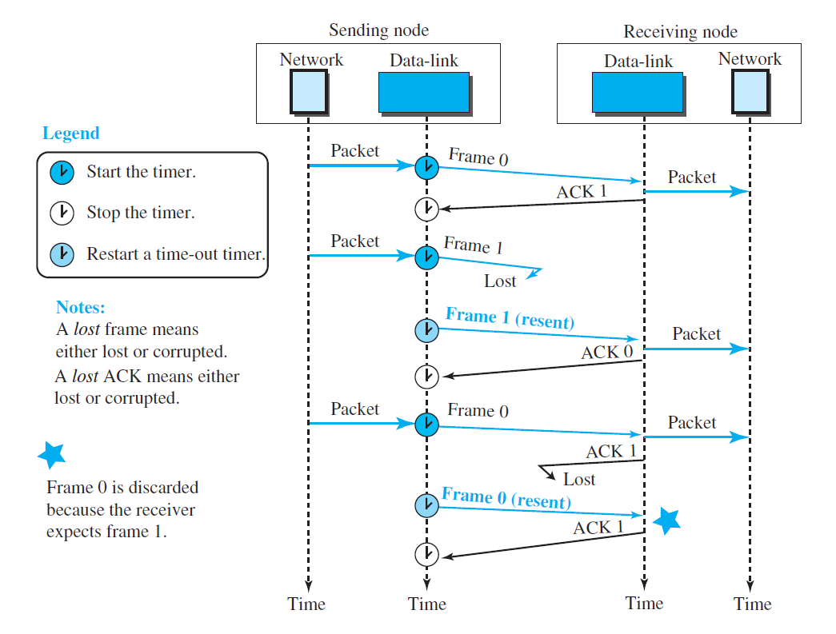
Figure 11.13

Slide 29
Algorithm 11.3 Sender-site algorithm for Stop-and-Wait Protocol

Slide 30
Algorithm 11.4 Receiver-site algorithm for Stop-and-Wait Protocol

Slide 31
Example 11.2
Figure 11.9 shows an example of communication using this protocol.
It is still very simple. The sender sends one frame and waits for feedback from the receiver.
When the ACK arrives, the sender sends the next frame. Note that sending two frames in the protocol involves the sender in four events and the receiver in two events.

Slide 32
NOISY CHANNELS
Although the Stop-and-Wait Protocol gives us an idea of how to add flow control to its predecessor, noiseless channels are nonexistent. We discuss three protocols in this section that use error control.
Stop-and-Wait Automatic Repeat Request
Go-Back-N Automatic Repeat Request
Selective Repeat Automatic Repeat Request

Slide 33
Note
Error correction in Stop-and-Wait ARQ is done by keeping a copy of the sent frame and retransmitting of the frame when the timer expires.

Slide 34
Note
In Stop-and-Wait ARQ, we use sequence numbers to number the frames.
The sequence numbers are based on modulo-2 arithmetic.

Slide 35
Note
In Stop-and-Wait ARQ, the acknowledgment number always announces in modulo-2 arithmetic the sequence number of the next frame expected.

Slide 36
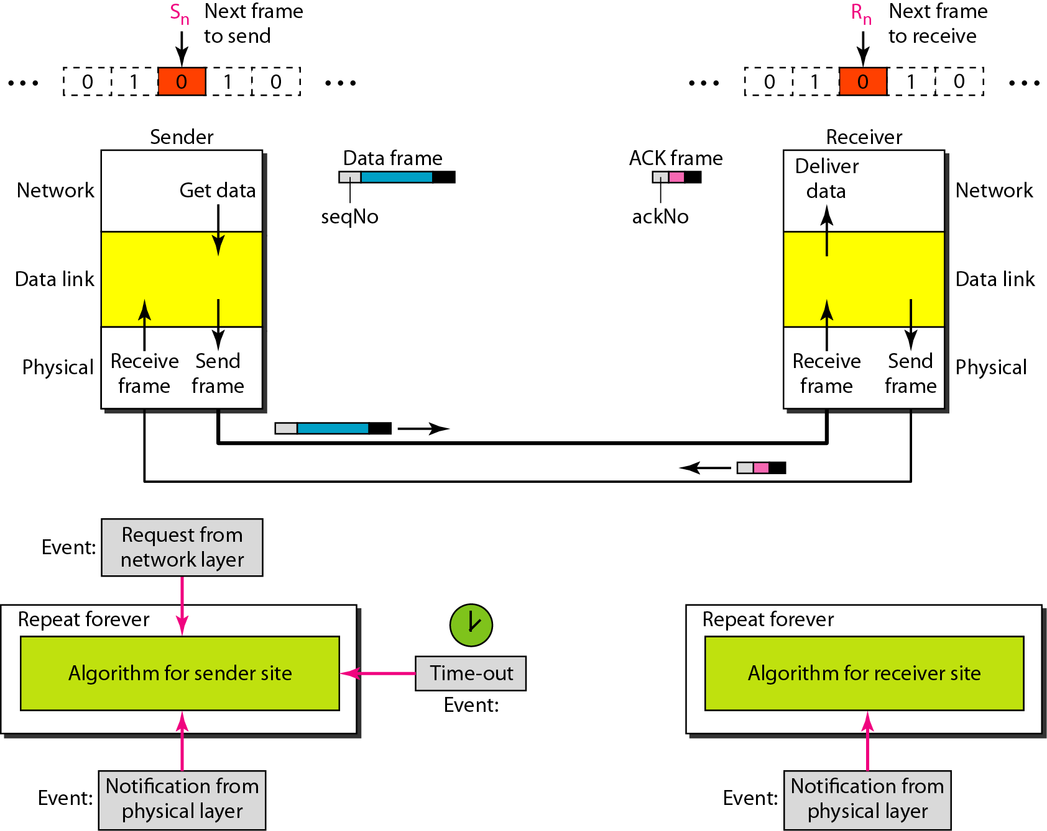
Figure 11.10 Design of the Stop-and-Wait ARQ Protocol

Slide 37
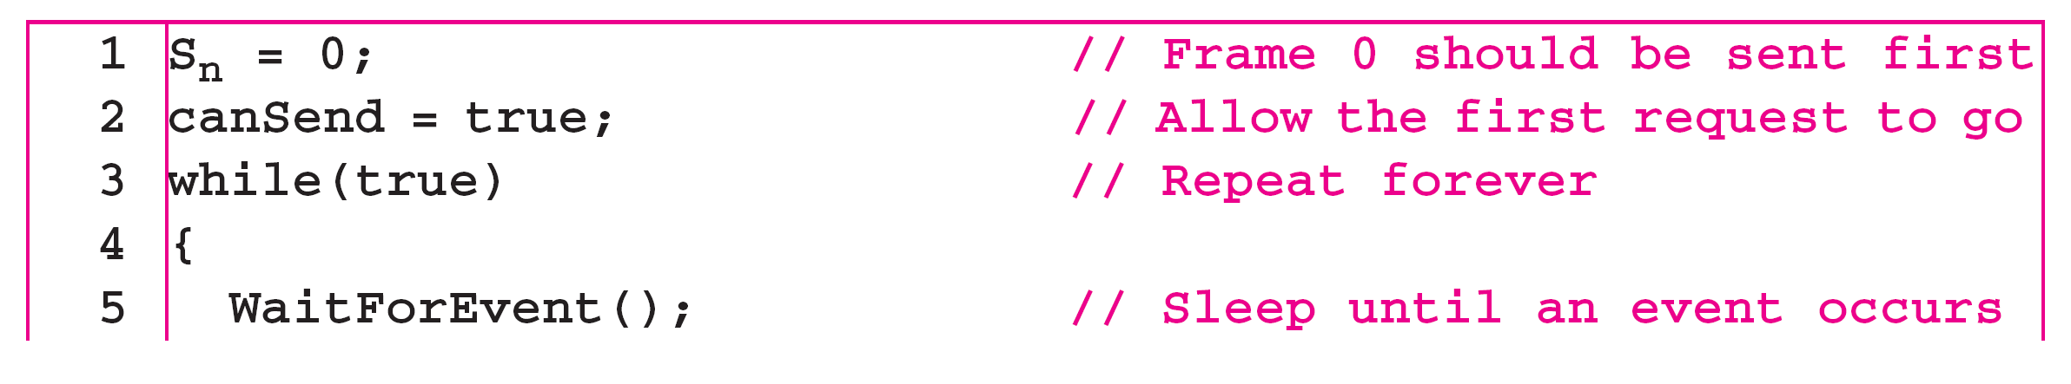
Algorithm 11.5 Sender-site algorithm for Stop-and-Wait ARQ
(continued)

Slide 38
Algorithm 11.5 Sender-site algorithm for Stop-and-Wait ARQ
(continued)

Slide 39
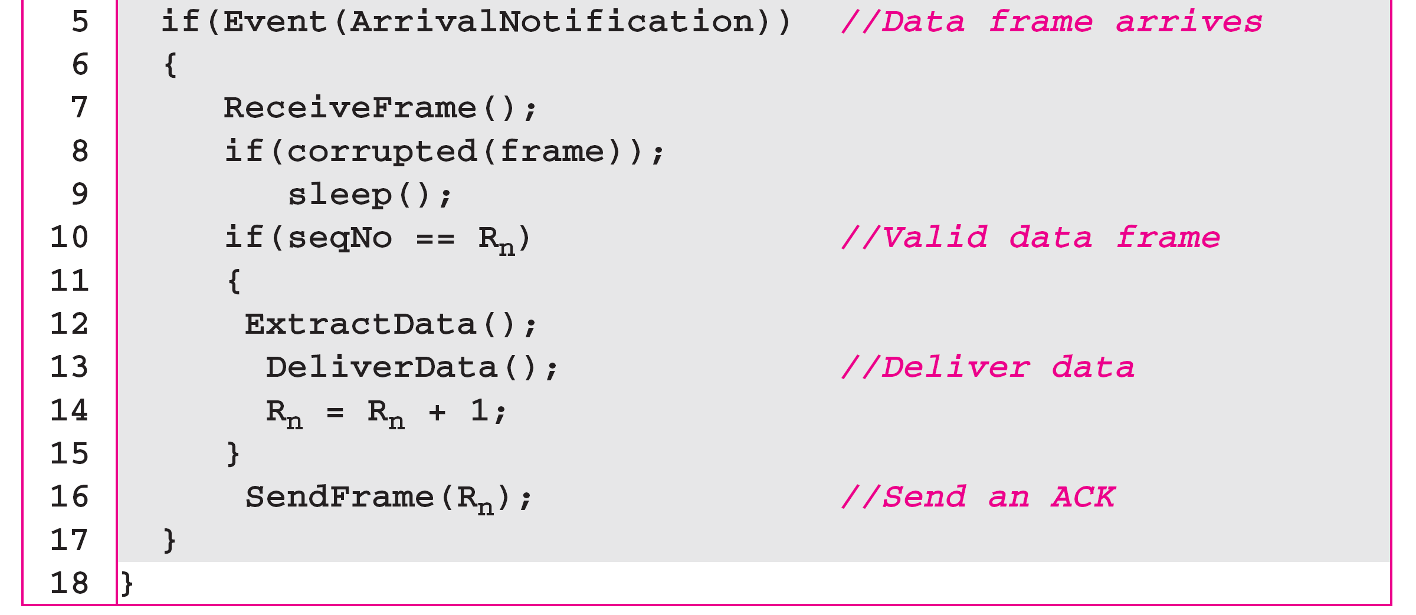
Algorithm 11.6 Receiver-site algorithm for Stop-and-Wait ARQ Protocol

Slide 40
Example 11.3
Figure 11.11 shows an example of Stop-and-Wait ARQ. Frame 0 is sent and acknowledged.
Frame 1 is lost and resent after the time-out.
The resent frame 1 is acknowledged and the timer stops. Frame 0 is sent and acknowledged, but the acknowledgment is lost.
The sender has no idea if the frame or the acknowledgment is lost, so after the time-out, it resends frame 0, which is acknowledged.

Slide 41
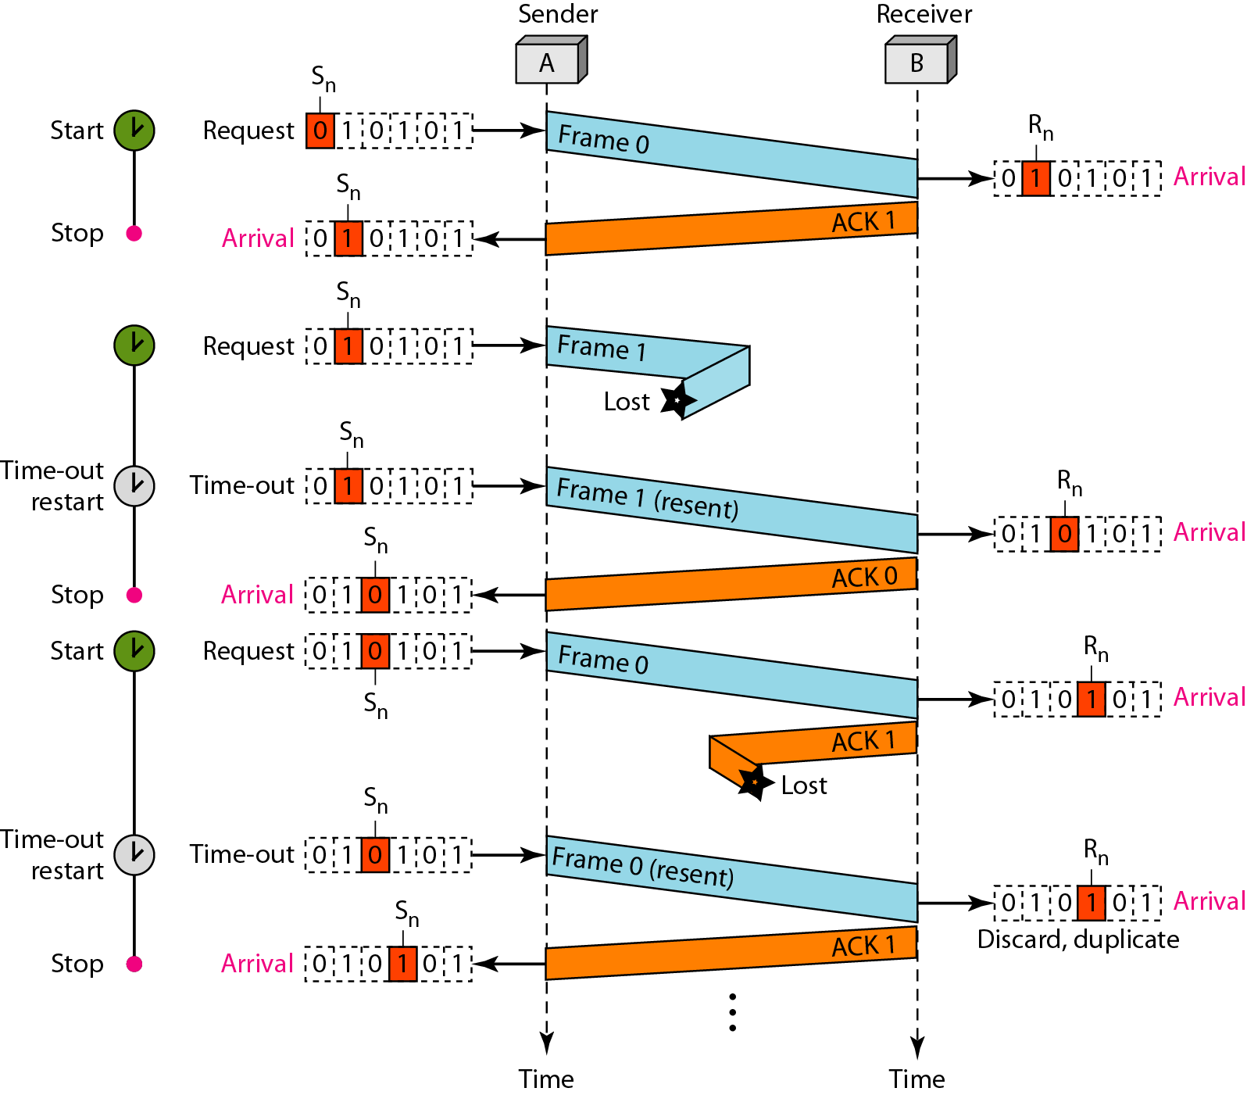
Figure 11.11 Flow diagram for Example 11.3

Slide 42
Example 11.4
Assume that, in a Stop-and-Wait ARQ system, the bandwidth of the line is 1 Mbps, and 1 bit takes 20 ms to make a round trip. What is the bandwidth-delay product? If the system data frames are 1000 bits in length, what is the utilization percentage of the link?
Solution
The bandwidth-delay product is

Slide 43
Example 11.4 (continued)
The system can send 20,000 bits during the time it takes for the data to go from the sender to the receiver and then back again.
However, the system sends only 1000 bits.
We can say that the link utilization is only 1000/20,000, or 5 percent.
For this reason, for a link with a high bandwidth or long delay, the use of Stop-and-Wait ARQ wastes the capacity of the link.

Slide 44
Example 11.5
What is the utilization percentage of the link in Example 11.4 if we have a protocol that can send up to 15 frames before stopping and worrying about the acknowledgments?
Solution
The bandwidth-delay product is still 20,000 bits. The system can send up to 15 frames or 15,000 bits during a round trip. This means the utilization is 15,000/20,000, or 75 percent. Of course, if there are damaged frames, the utilization percentage is much less because frames have to be resent.

Slide 45
Note
In the Go-Back-N Protocol, the sequence numbers are modulo 2^{m},
where m is the size of the sequence number field in bits.

Slide 46
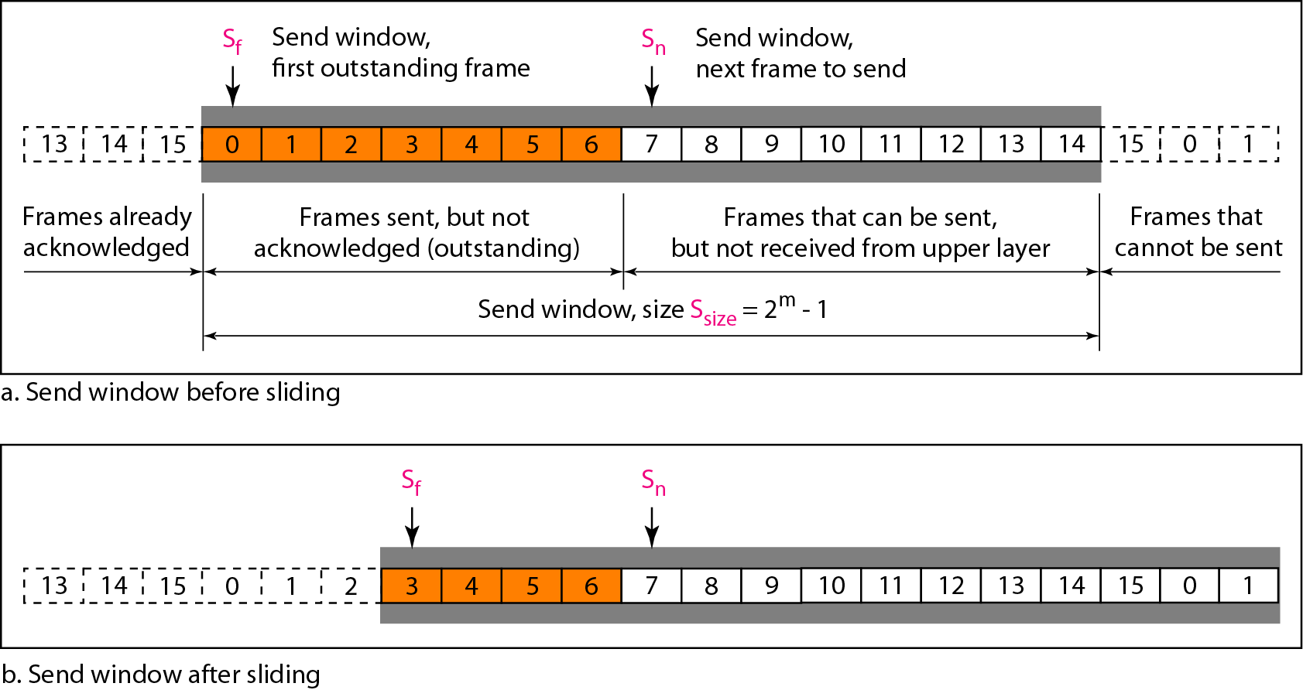
Figure 11.12 Send window for Go-Back-N ARQ

Slide 47
Note
The send window is an abstract concept defining an imaginary box of size 2^{m} − 1 with three variables: Sf, Sn, and S_{size}.

Slide 48
Note
The send window can slide one or more slots when a valid acknowledgment arrives.

Slide 49
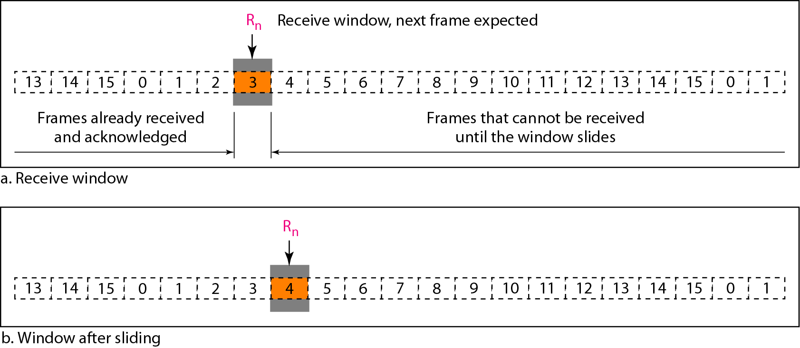
Figure 11.13 Receive window for Go-Back-N ARQ

Slide 50
Note
The receive window is an abstract concept defining an imaginary box
of size 1 with one single variable R_{n}. The window slides
when a correct frame has arrived; sliding occurs one slot at a time.

Slide 51
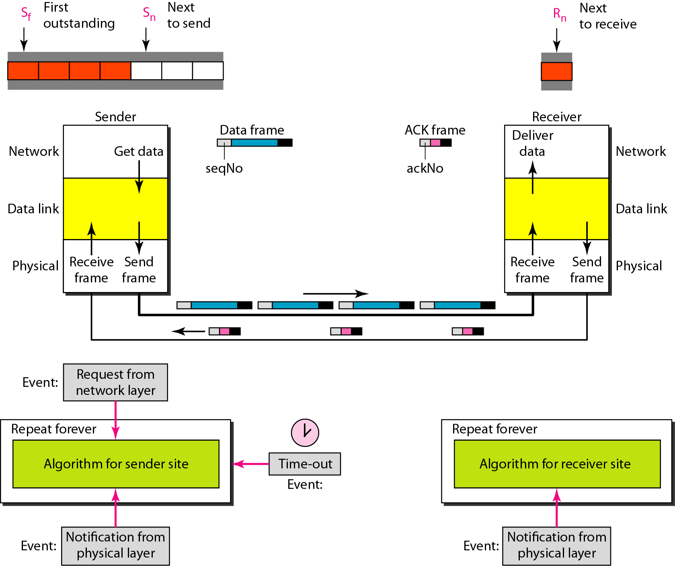
Figure 11.14 Design of Go-Back-N ARQ

Slide 52
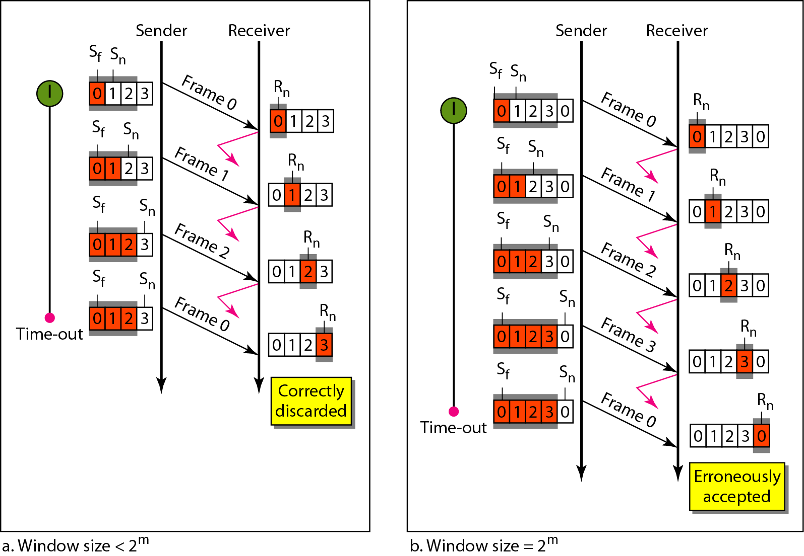
Figure 11.15 Window size for Go-Back-N ARQ

Slide 53
Note
In Go-Back-N ARQ, the size of the send window must be less than 2^{m};
the size of the receiver window is always 1.

Slide 54
Algorithm 11.7 Go-Back-N sender algorithm
(continued)

Slide 55
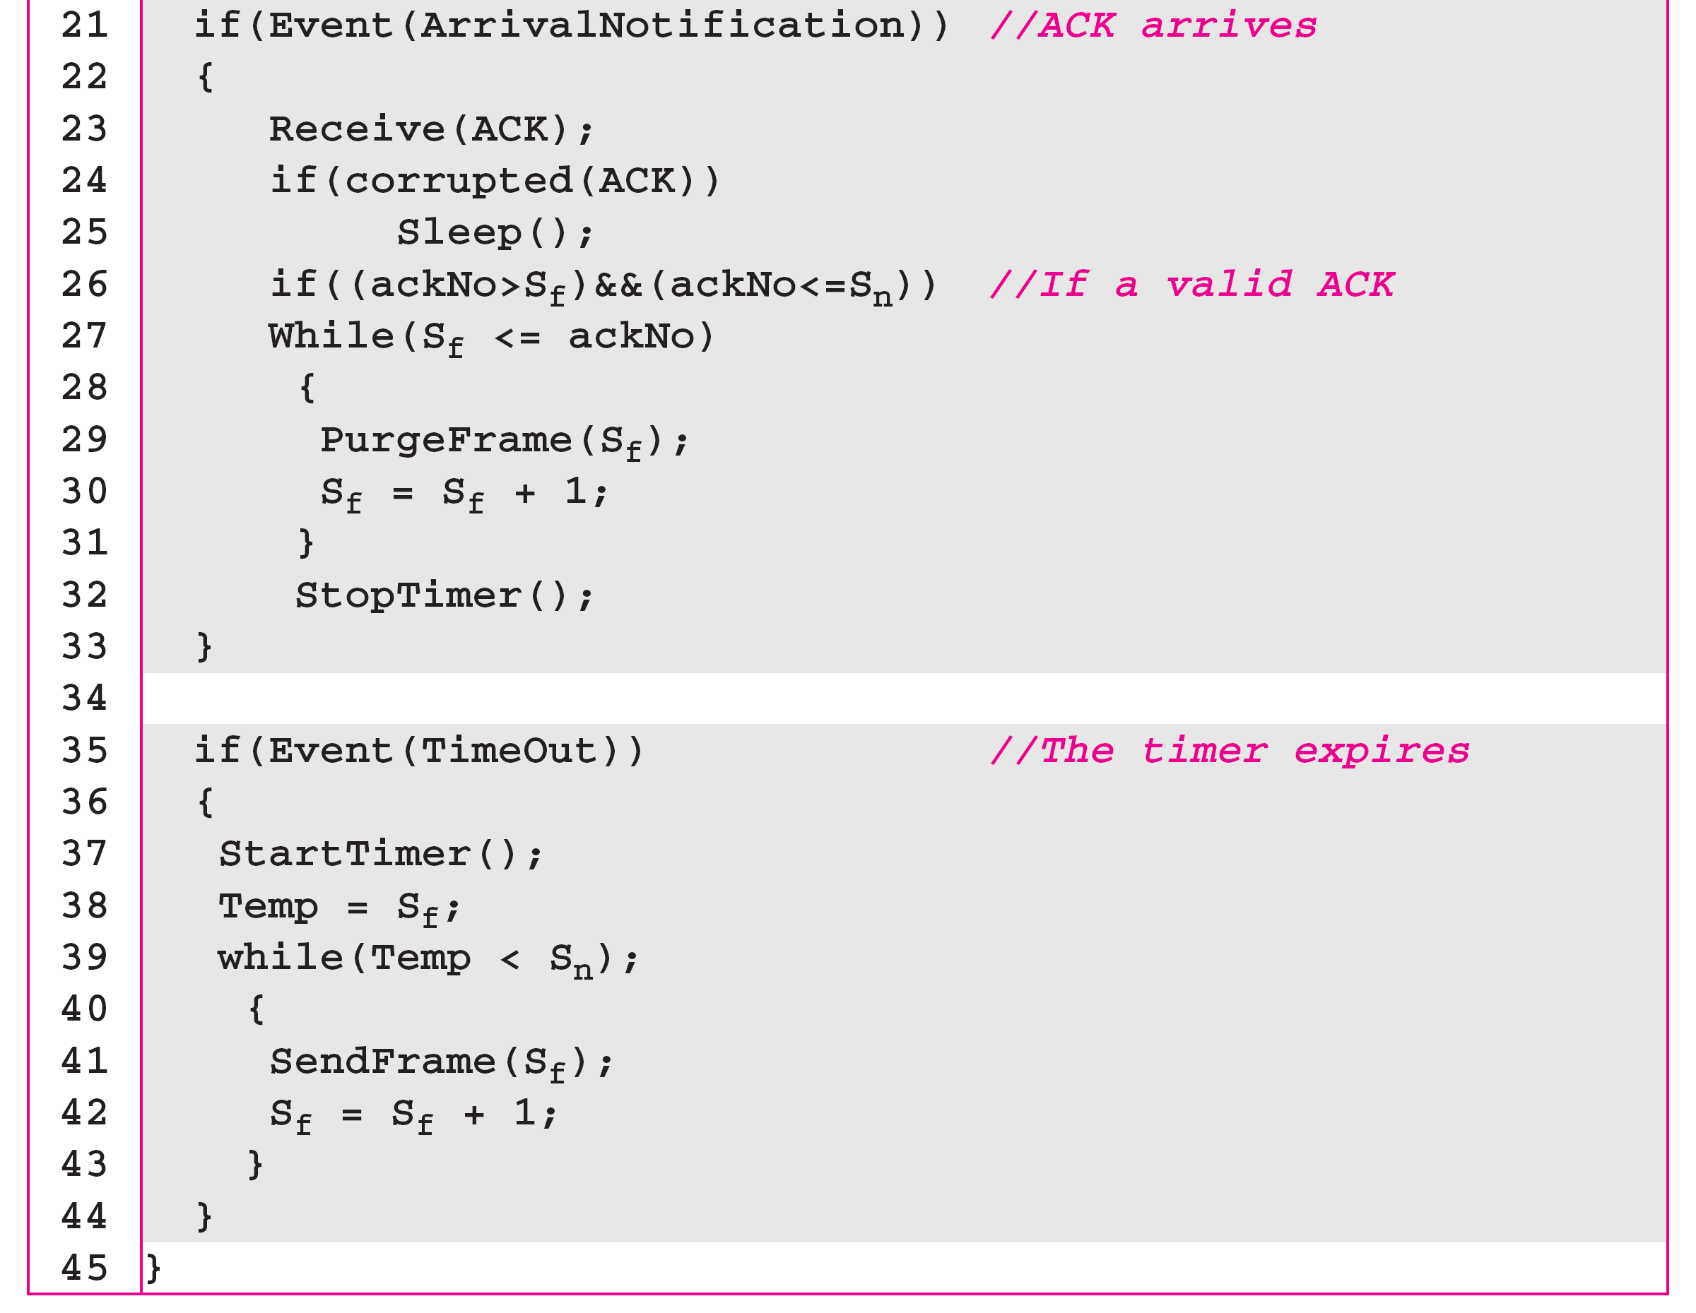
Algorithm 11.7 Go-Back-N sender algorithm
(continued)

Slide 56
Algorithm 11.8 Go-Back-N receiver algorithm

Slide 57
Example 11.6
Figure 11.16 shows an example of Go-Back-N.
This is an example of a case where the forward channel is reliable, but the reverse is not.
No data frames are lost, but some ACKs are delayed and one is lost.
The example also shows how cumulative acknowledgments can help if acknowledgments are delayed or lost.
After initialization, there are seven sender events.
Request events are triggered by data from the network layer; arrival events are triggered by acknowledgments from the physical layer. There is no time-out event here because all outstanding frames are acknowledged before the timer expires.
Note that although ACK 2 is lost, ACK 3 serves as both ACK 2 and ACK 3.

Slide 58
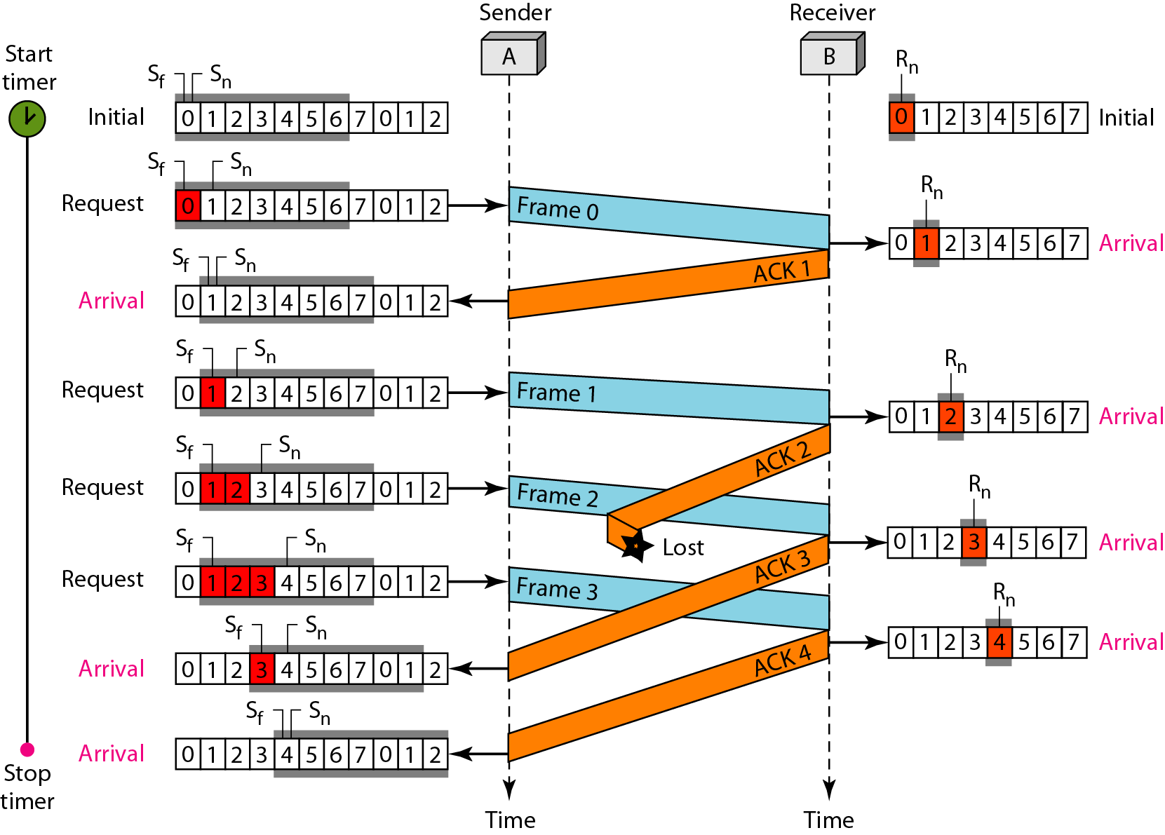
Figure 11.16 Flow diagram for Example 11.6

Slide 59
Example 11.7
Figure 11.17 shows what happens when a frame is lost. Frames 0, 1, 2, and 3 are sent.
However, frame 1 is lost.
The receiver receives frames 2 and 3, but they are discarded because they are received out of order.
The sender receives no acknowledgment about frames 1, 2, or 3. Its timer finally expires.
The sender sends all outstanding frames (1, 2, and 3) because it does not know what is wrong.
Note that the resending of frames 1, 2, and 3 is the response to one single event.
When the sender is responding to this event, it cannot accept the triggering of other events.
This means that when ACK 2 arrives, the sender is still busy with sending frame 3.

Slide 60
Example 11.7 (continued)
The physical layer must wait until this event is completed and the data link layer goes back to its sleeping state.
We have shown a vertical line to indicate the delay.
It is the same story with ACK 3; but when ACK 3 arrives, the sender is busy responding to ACK 2.
It happens again when ACK 4 arrives.
Note that before the second timer expires, all outstanding frames have been sent and the timer is stopped.

Slide 61
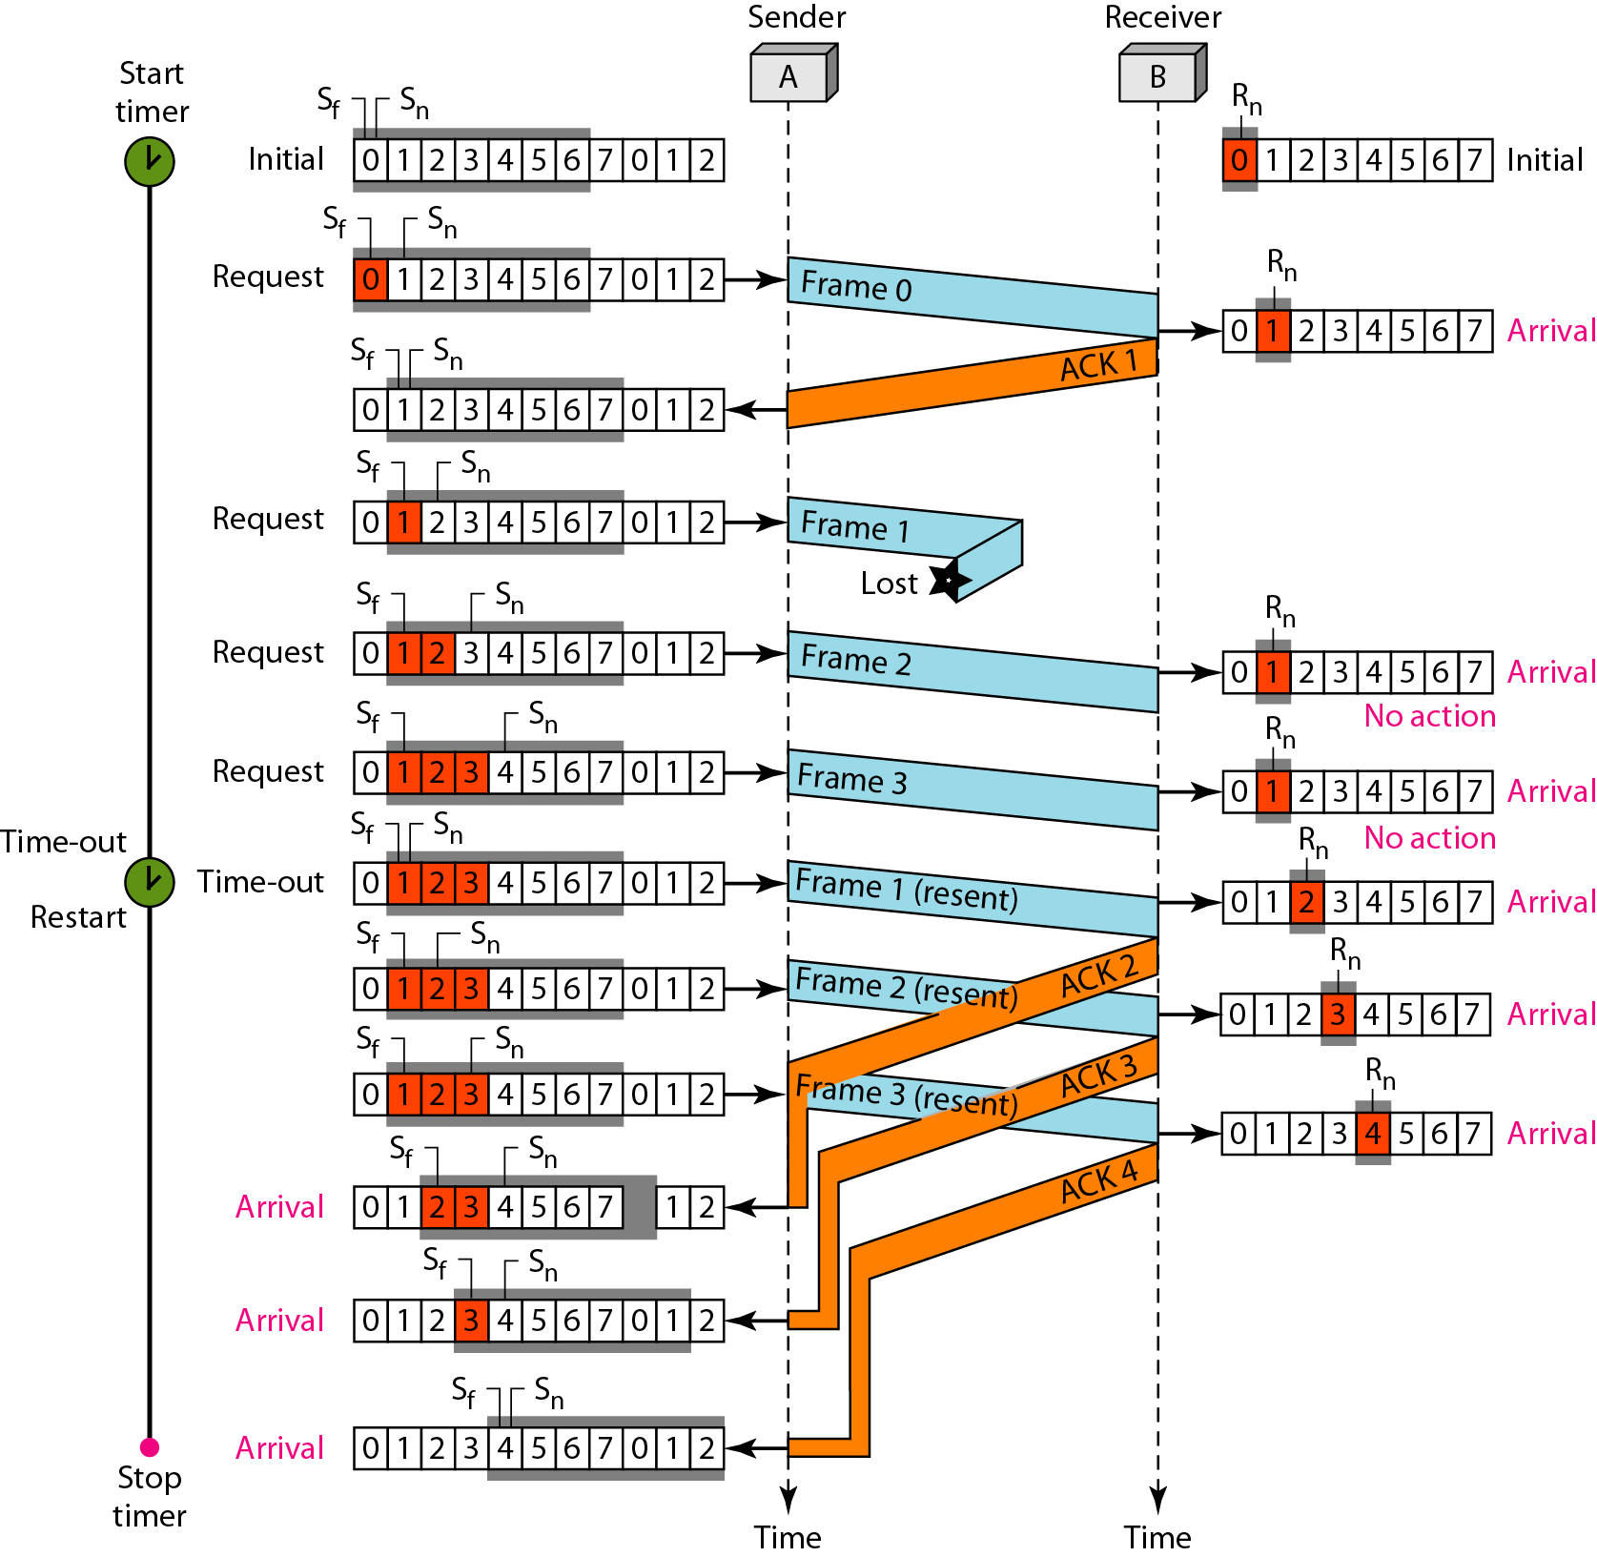
Figure 11.17 Flow diagram for Example 11.7

Slide 62
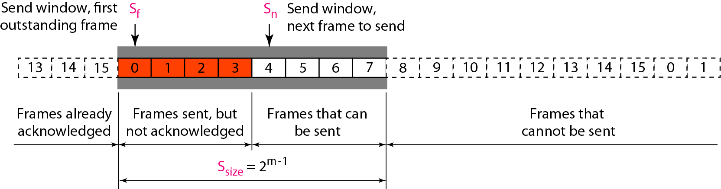
Figure 11.18 Send window for Selective Repeat ARQ

Slide 63
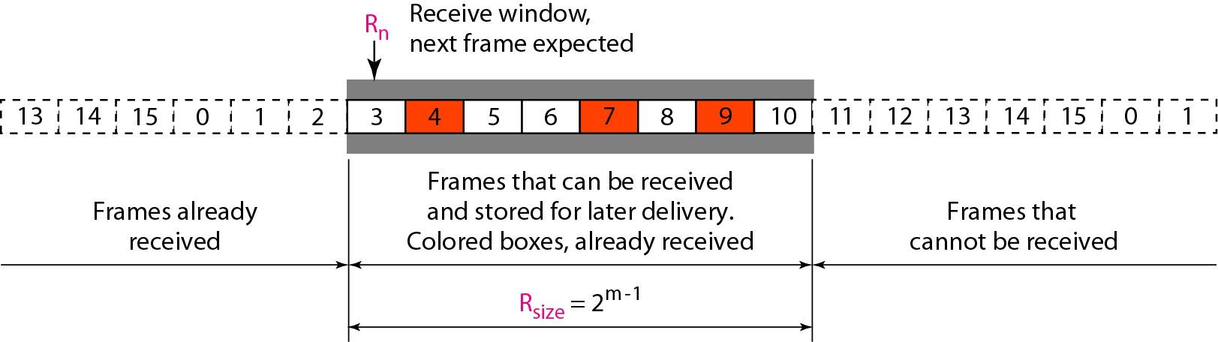
Figure 11.19 Receive window for Selective Repeat ARQ

Slide 64
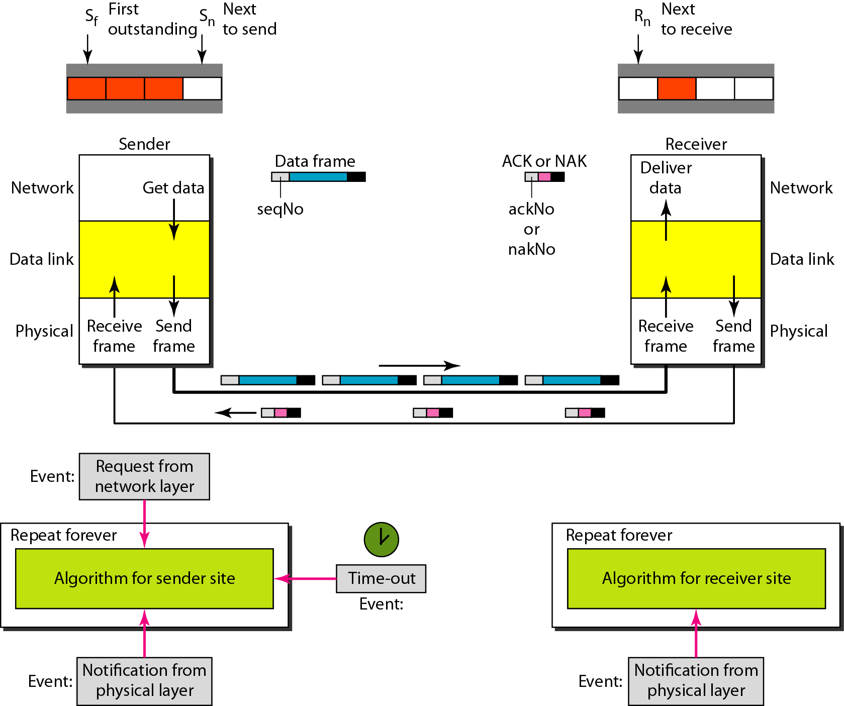
Figure 11.20 Design of Selective Repeat ARQ

Slide 65
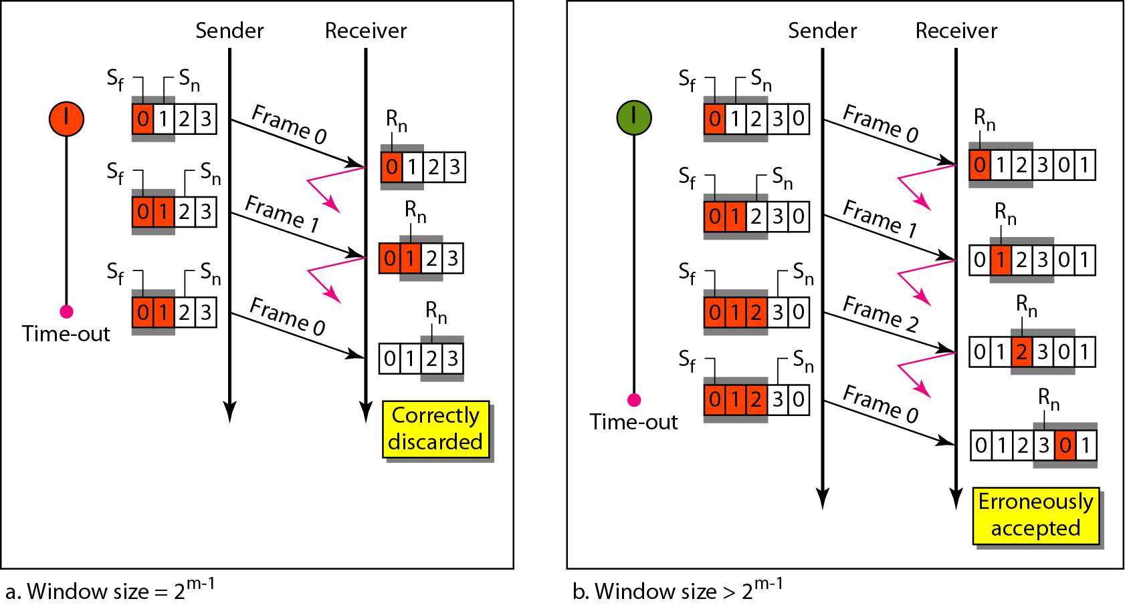
Figure 11.21 Selective Repeat ARQ, window size

Slide 66
Note
In Selective Repeat ARQ, the size of the sender and receiver window
must be at most one-half of 2^{m}.

Slide 67
Algorithm 11.9 Sender-site Selective Repeat algorithm
(continued)

Slide 68
Algorithm 11.9 Sender-site Selective Repeat algorithm
(continued)
(continued)

Slide 69
Algorithm 11.9 Sender-site Selective Repeat algorithm
(continued)

Slide 70
Algorithm 11.10 Receiver-site Selective Repeat algorithm

Slide 71
Algorithm 11.10 Receiver-site Selective Repeat algorithm

Slide 72
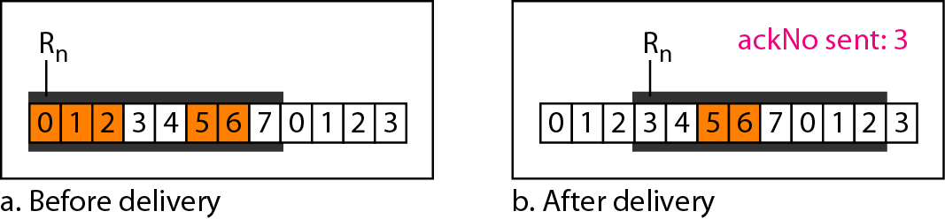
Figure 11.22 Delivery of data in Selective Repeat ARQ

Slide 73
Example 11.8
This example is similar to Example 11.3 in which frame 1 is lost. We show how Selective Repeat behaves in this case. Figure 11.23 shows the situation. One main difference is the number of timers. Here, each frame sent or resent needs a timer, which means that the timers need to be numbered (0, 1, 2, and 3). The timer for frame 0 starts at the first request, but stops when the ACK for this frame arrives. The timer for frame 1 starts at the second request, restarts when a NAK arrives, and finally stops when the last ACK arrives. The other two timers start when the corresponding frames are sent and stop at the last arrival event.

Slide 74
Example 11.8 (continued)
At the receiver site we need to distinguish between the acceptance of a frame and its delivery to the network layer. At the second arrival, frame 2 arrives and is stored and marked, but it cannot be delivered because frame 1 is missing. At the next arrival, frame 3 arrives and is marked and stored, but still none of the frames can be delivered. Only at the last arrival, when finally a copy of frame 1 arrives, can frames 1, 2, and 3 be delivered to the network layer. There are two conditions for the delivery of frames to the network layer: First, a set of consecutive frames must have arrived. Second, the set starts from the beginning of the window.

Slide 75
Example 11.8 (continued)
Another important point is that a NAK is sent after the second arrival, but not after the third, although both situations look the same. The reason is that the protocol does not want to crowd the network with unnecessary NAKs and unnecessary resent frames. The second NAK would still be NAK1 to inform the sender to resend frame 1 again; this has already been done. The first NAK sent is remembered (using the nakSent variable) and is not sent again until the frame slides. A NAK is sent once for each window position and defines the first slot in the window.

Slide 76
Example 11.8 (continued)
The next point is about the ACKs. Notice that only two ACKs are sent here. The first one acknowledges only the first frame; the second one acknowledges three frames. In Selective Repeat, ACKs are sent when data are delivered to the network layer. If the data belonging to n frames are delivered in one shot, only one ACK is sent for all of them.

Slide 77
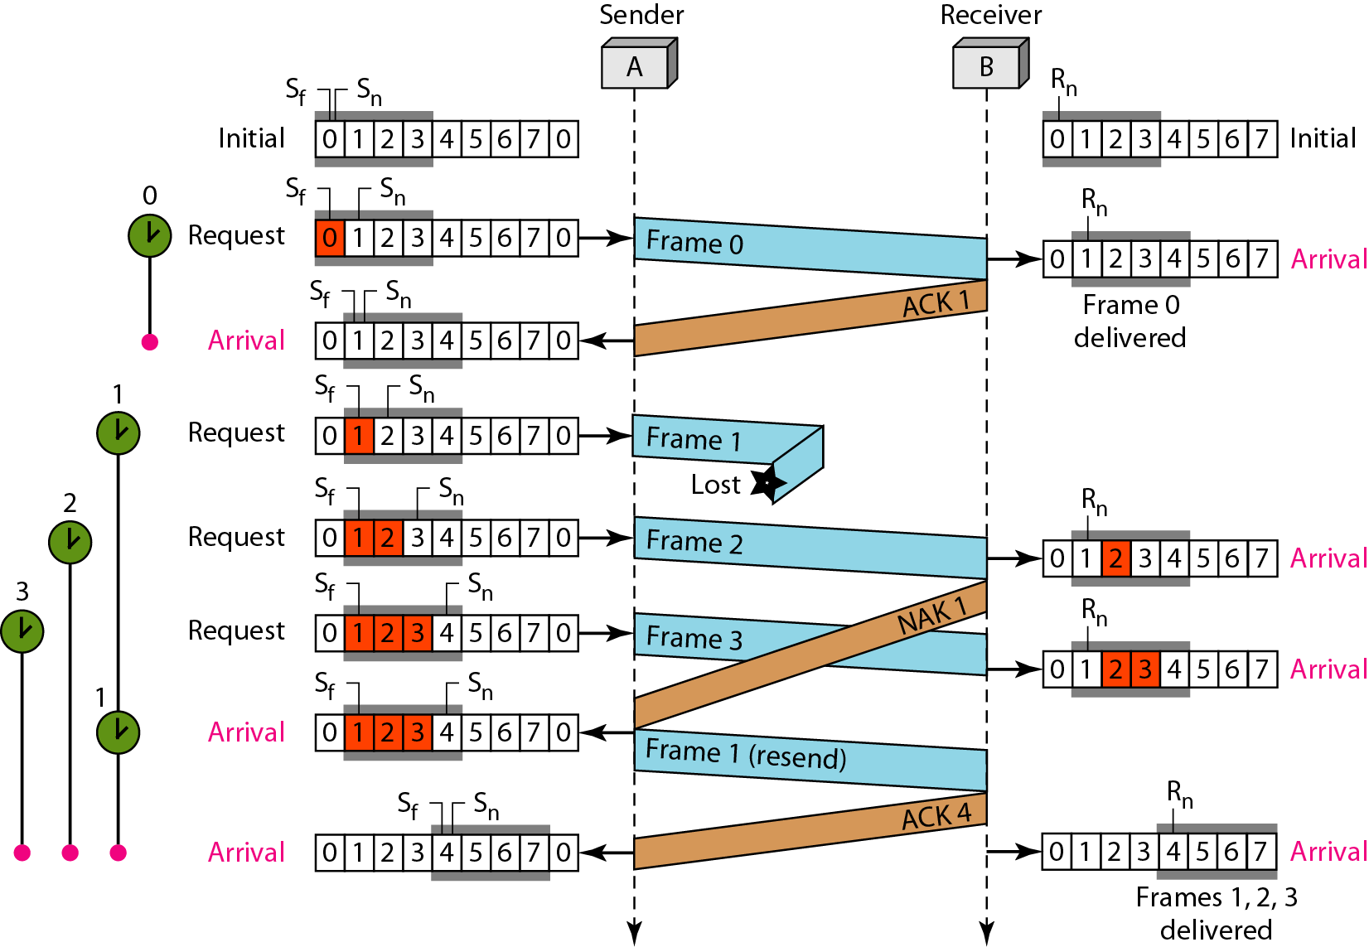
Figure 11.23 Flow diagram for Example 11.8

Slide 78
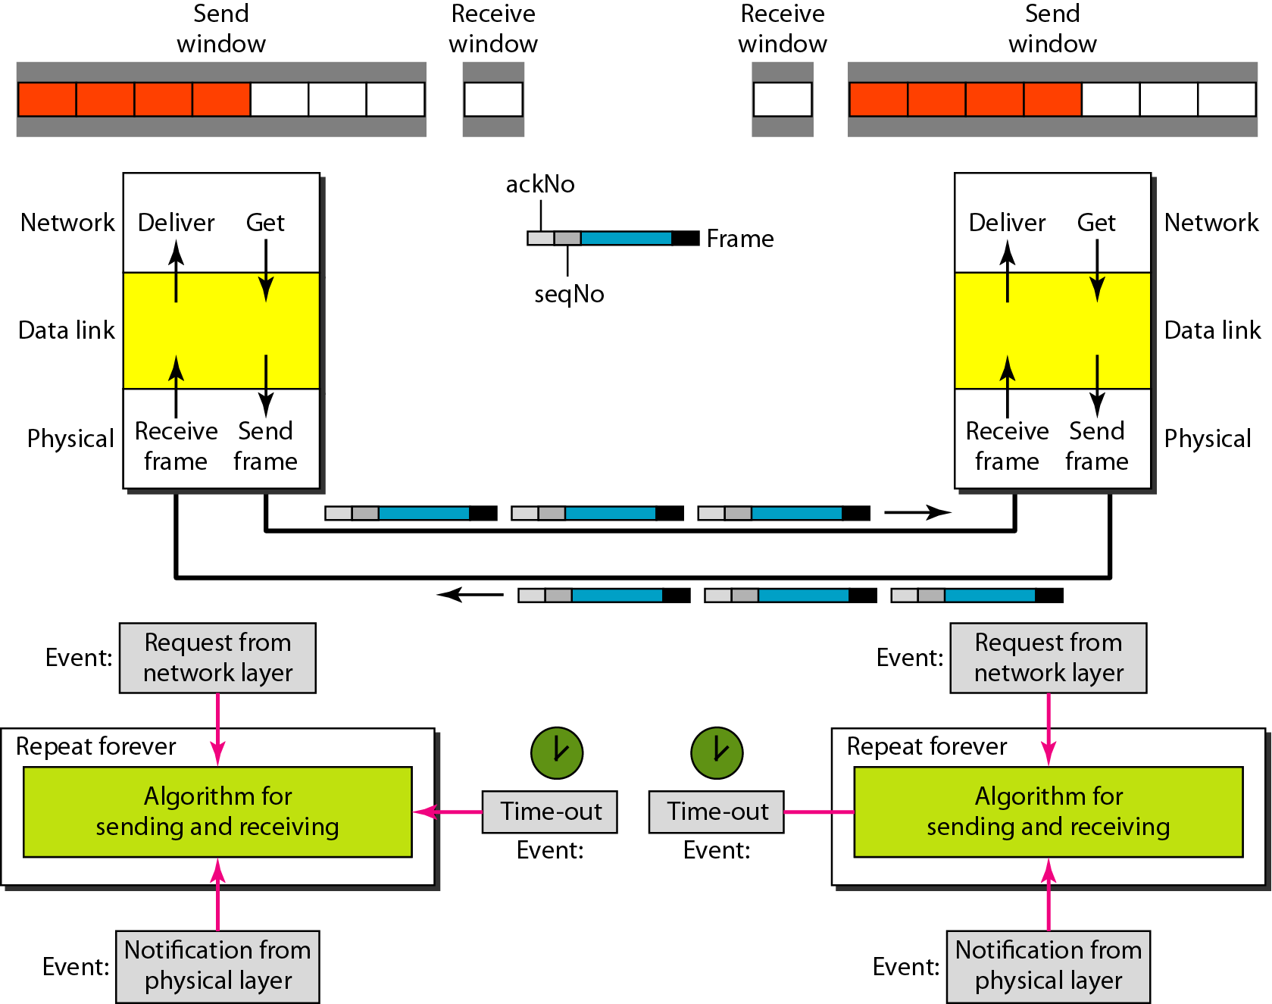
Figure 11.24 Design of piggybacking in Go-Back-N ARQ

Slide 79
HDLC
High-level Data Link Control (HDLC) is a bit-oriented protocol for communication over point-to-point and multipoint links.
It implements the ARQ mechanisms we discussed in this chapter.
Most of the concept defined in this protocol is the basis for other practical protocols such as PPP, which we discuss next, or the Ethernet protocol.

Slide 80
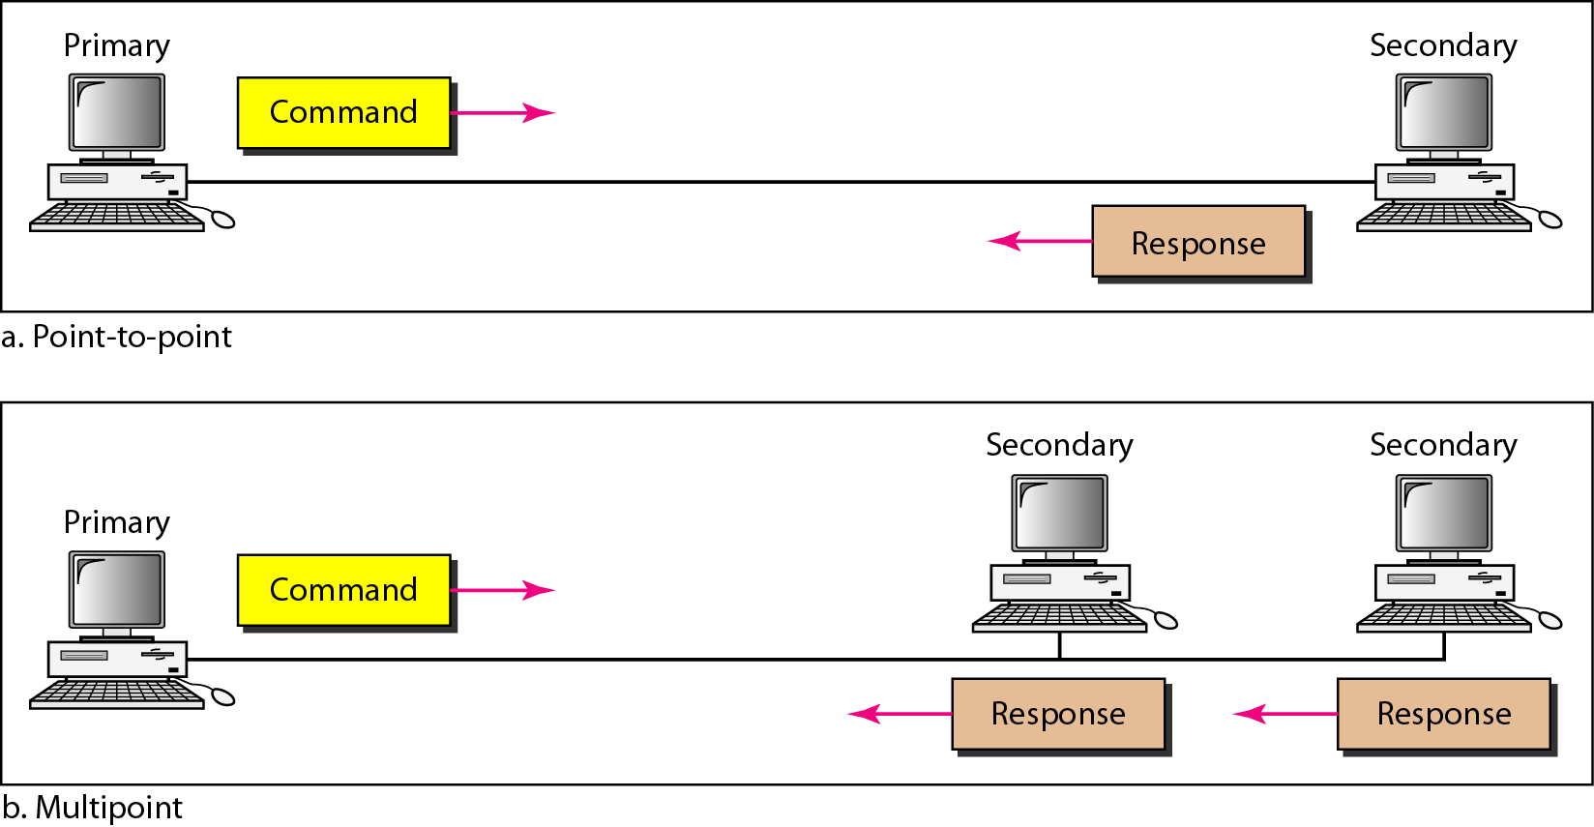
Figure 11.25 Normal response mode
In normal response mode (NRM), the station configuration is unbalanced. We have one primary station and multiple secondary stations. A primary station can send commands; a secondary station can only respond. The NRM is used for both point-to-point and multipoint
links, as shown in Figure.

Slide 81
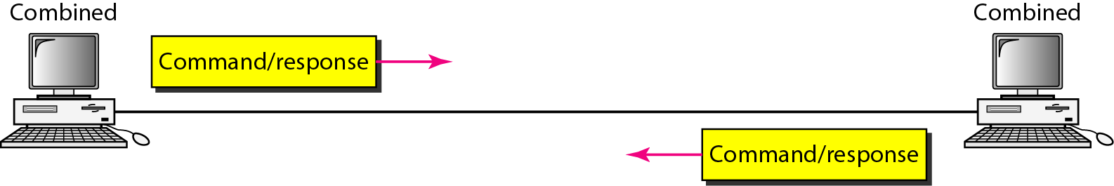
Figure 11.26 Asynchronous balanced mode
In ABM, the configuration is balanced. The link is point-to-point, and each station can function as a primary and a secondary (acting as peers), as shown in Figure. This is the common mode today.

Slide 82
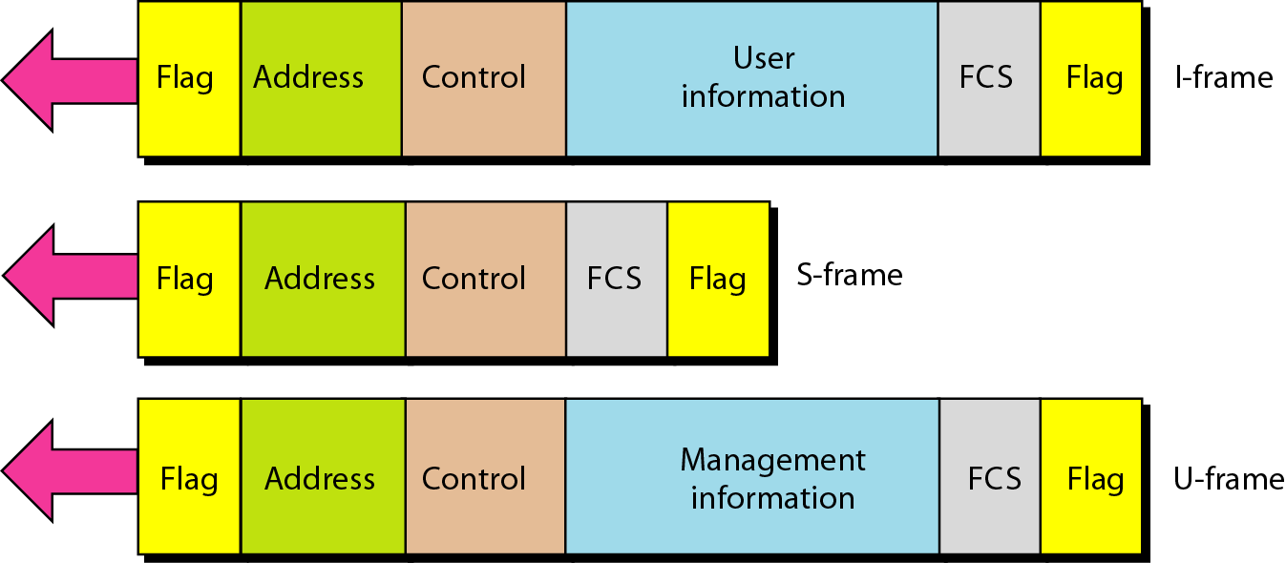
Figure 11.27 HDLC frames
(information frames)
(supervisory frames)
(unnumbered frames)

Slide 83
The fields and their use in different frame types.
Flag field. This field contains synchronization pattern 01111110, which identifies both the beginning and the end of a frame.
Address field. This field contains the address of the secondary station. If a primary station created the frame, it contains a to address. If a secondary station creates the frame, it contains a from address. The address field can be one byte or several bytes long, depending on the needs of the network.
Control field. The control field is one or two bytes used for flow and error control. The interpretation of bits are discussed later. The control field determines the type of frame and defines its functionality.
Information field. The information field contains the user’s data from the network layer or management information. Its length can vary from one network to another.
FCS field. The frame check sequence (FCS) is the HDLC error detection field. It can contain either a 2- or 4-byte CRC.

Slide 84
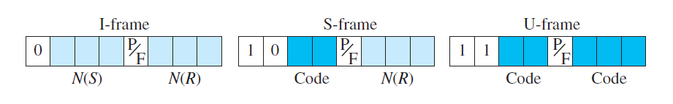
Control field format for I frame
The first bit defines the type. If the first bit of the control field is 0, this means the frame is an I-frame.
The next 3 bits, called N(S), define the sequence number of the frame. Note that with 3 bits, we can define a sequence number between 0 and 7.
The last 3 bits, called N(R), correspond to the acknowledgment number when piggybacking is used.
The P/F field is a single bit with a dual purpose. It means poll when the frame is sent by a primary station to a secondary (when the address field contains the address of the receiver). It means final when the frame is sent by a secondary to a primary station.

Slide 85
Control field format for S frame
If the first 2 bits of the control field are 10, this means the frame is an S-frame. The last 3 bits, called N(R), correspond to the acknowledgment number (ACK) or negative acknowledgment number (NAK), depending on the type of S-frame.
The 2 bits called code are used to define the type of S-frame itself. With 2 bits, we can have four types of S-frames, as described below:
Receive ready (RR). If the value of the code subfield is 00, it is an RR S-frame. This kind of frame acknowledges the receipt of a safe and sound frame or group of frames. In this case, the value of the N(R) field defines the acknowledgment number.
Receive not ready (RNR). If the value of the code subfield is 10, it is an RNR S-frame.
This kind of frame is an RR frame with additional functions. It acknowledges the receipt of a frame or group of frames, and it announces that the receiver is busy and cannot receive more frames. It acts as a kind of congestion-control mechanism by asking the sender to slow down. The value of N(R) is the acknowledgment number.

Slide 86
Control field format for S frame
Reject (REJ). If the value of the code subfield is 01, it is an REJ S-frame. This is a NAK frame, but not like the one used for Selective Repeat ARQ. It is a NAK that can be used in Go-Back-N ARQ to improve the efficiency of the process by informing the sender, before the sender timer expires, that the last frame is lost or damaged. The value of N(R) is the negative acknowledgment number.
Selective reject (SREJ). If the value of the code subfield is 11, it is an SREJ Sframe. This is a NAK frame used in Selective Repeat ARQ. Note that the HDLC Protocol uses the term selective reject instead of selective repeat. The value of N(R) is the negative acknowledgment number.

Slide 87
Control field format for U frame
Unnumbered frames are used to exchange session management and control information between connected devices.
Unlike S-frames, U-frames contain an information field, but one used for system management information, not user data. As with S-frames, however, much of the information carried by U-frames is contained in codes included in the control field.
U-frame codes are divided into two sections: a 2-bit prefix before the P/F bit and a 3-bit suffix after the P/F bit.
Together, these two segments (5 bits) can be used to create up to 32 different types of U-frames.

Slide 88
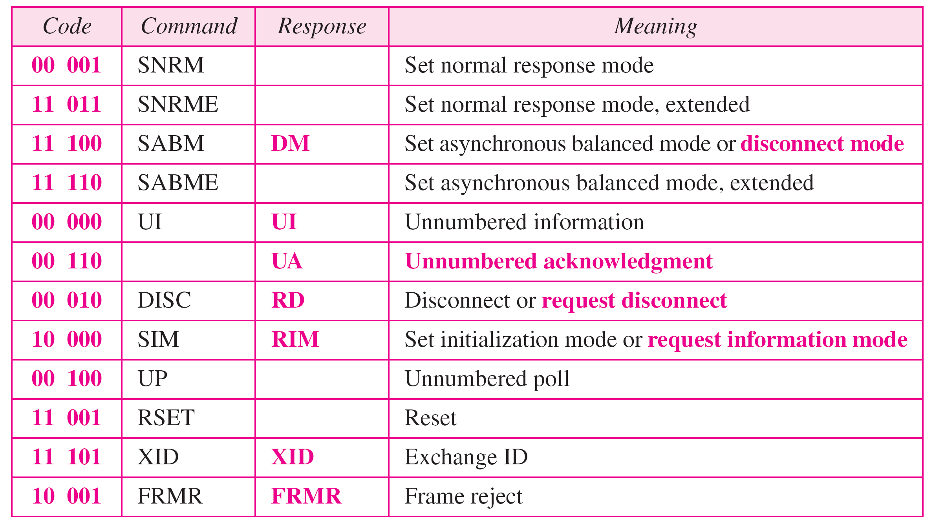
Table 11.1 U-frame control command and response

Slide 89
Example 11.9
Figure 11.29 shows how U-frames can be used for connection establishment and connection release.
Node A asks for a connection with a set asynchronous balanced mode (SABM) frame; node B gives a positive response with an unnumbered acknowledgment (UA) frame.
After these two exchanges, data can be transferred between the two nodes (not shown in the figure).
After data transfer, node A sends a DISC (disconnect) frame to release the connection; it is confirmed by node B responding with a UA (unnumbered acknowledgment).

Slide 90
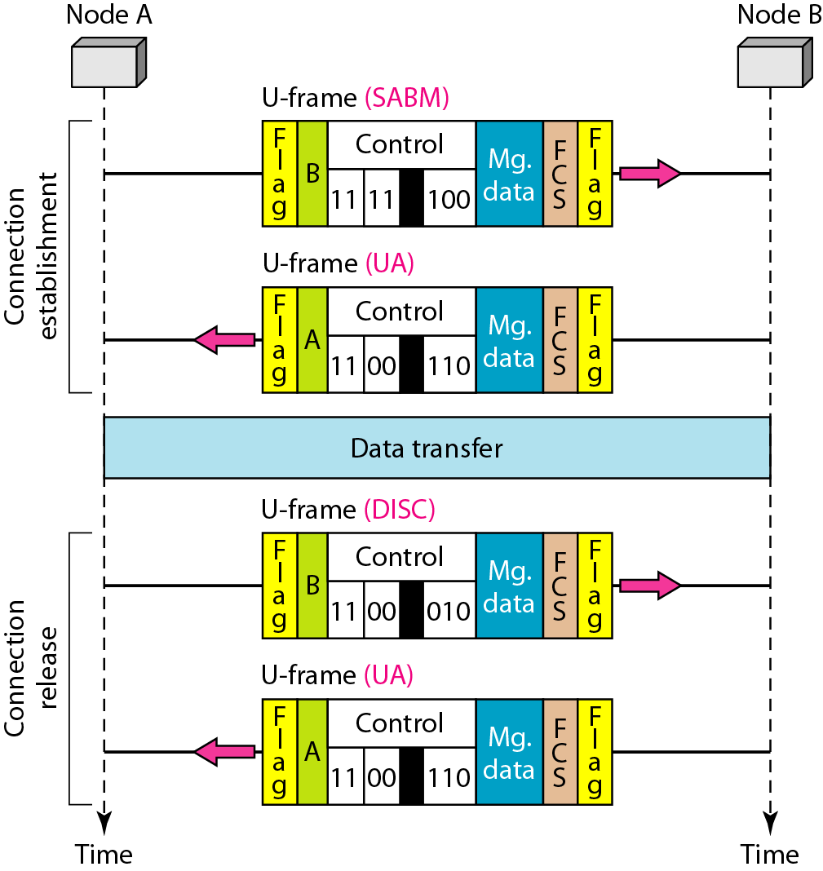
Figure 11.29 Example of connection and disconnection

Slide 91
Example 11.10
Figure 11.30 shows an exchange using piggybacking.
Node A begins the exchange of information with an I-frame numbered 0 followed by another I-frame numbered 1.
Node B piggybacks its acknowledgment of both frames onto an I-frame of its own.
Node B’s first I-frame is also numbered 0 [N(S) field] and contains a 2 in its N(R) field, acknowledging the receipt of A’s frames 1 and 0 and indicating that it expects frame 2 to arrive next.
Node B transmits its second and third I-frames (numbered 1 and 2) before accepting further frames from node A.
Its N(R) information, therefore, has not changed: B frames 1 and 2 indicate that node B is still expecting A’s frame 2 to arrive next.
Node A has sent all its data. Therefore, it cannot piggyback an acknowledgment onto an I-frame and sends an S-frame instead.
The RR code indicates that A is still ready to receive.
The number 3 in the N(R) field tells B that frames 0, 1, and 2 have all been accepted and that A is now expecting frame number 3.

Slide 92
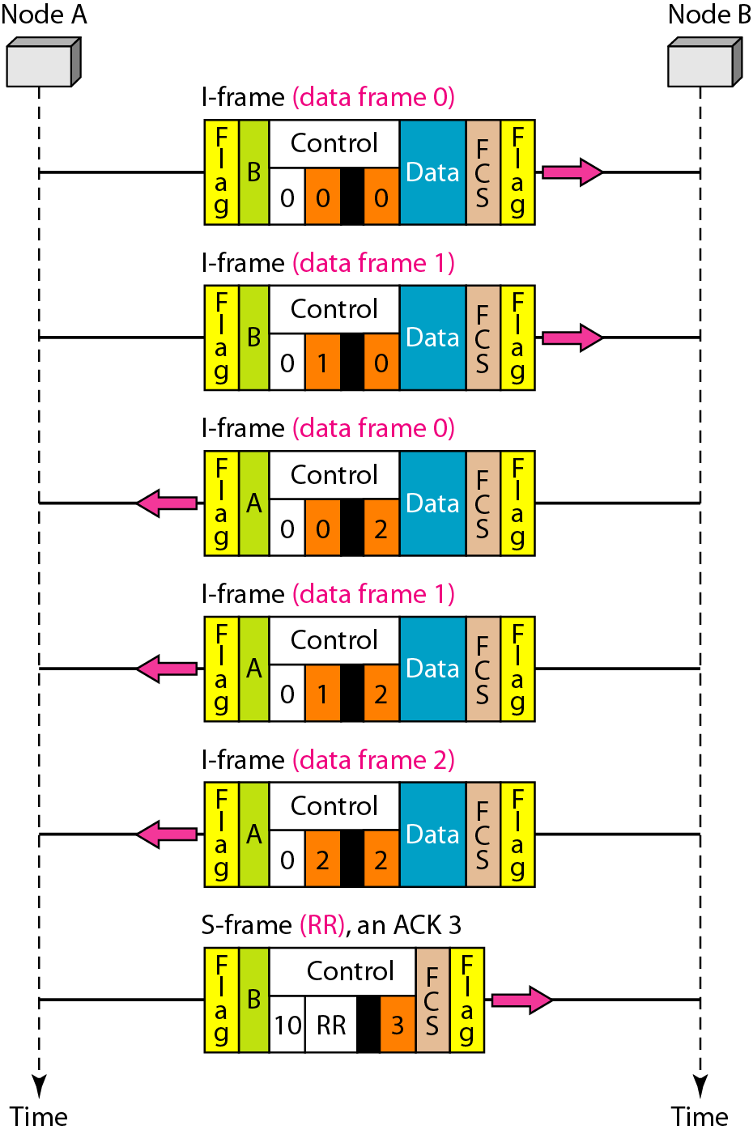
Figure 11.30 Example of piggybacking without error

Slide 93
Example 11.11
Figure 11.31 shows an exchange in which a frame is lost. Node B sends three data frames (0, 1, and 2), but frame 1 is lost.
When node A receives frame 2, it discards it and sends a REJ frame for frame 1.
Note that the protocol being used is Go-Back-N with the special use of an REJ frame as a NAK frame.
The NAK frame does two things here: It confirms the receipt of frame 0 and declares that frame 1 and any following frames must be resent.
Node B, after receiving the REJ frame, resends frames 1 and 2.
Node A acknowledges the receipt by sending an RR frame (ACK) with acknowledgment number 3.

Slide 94
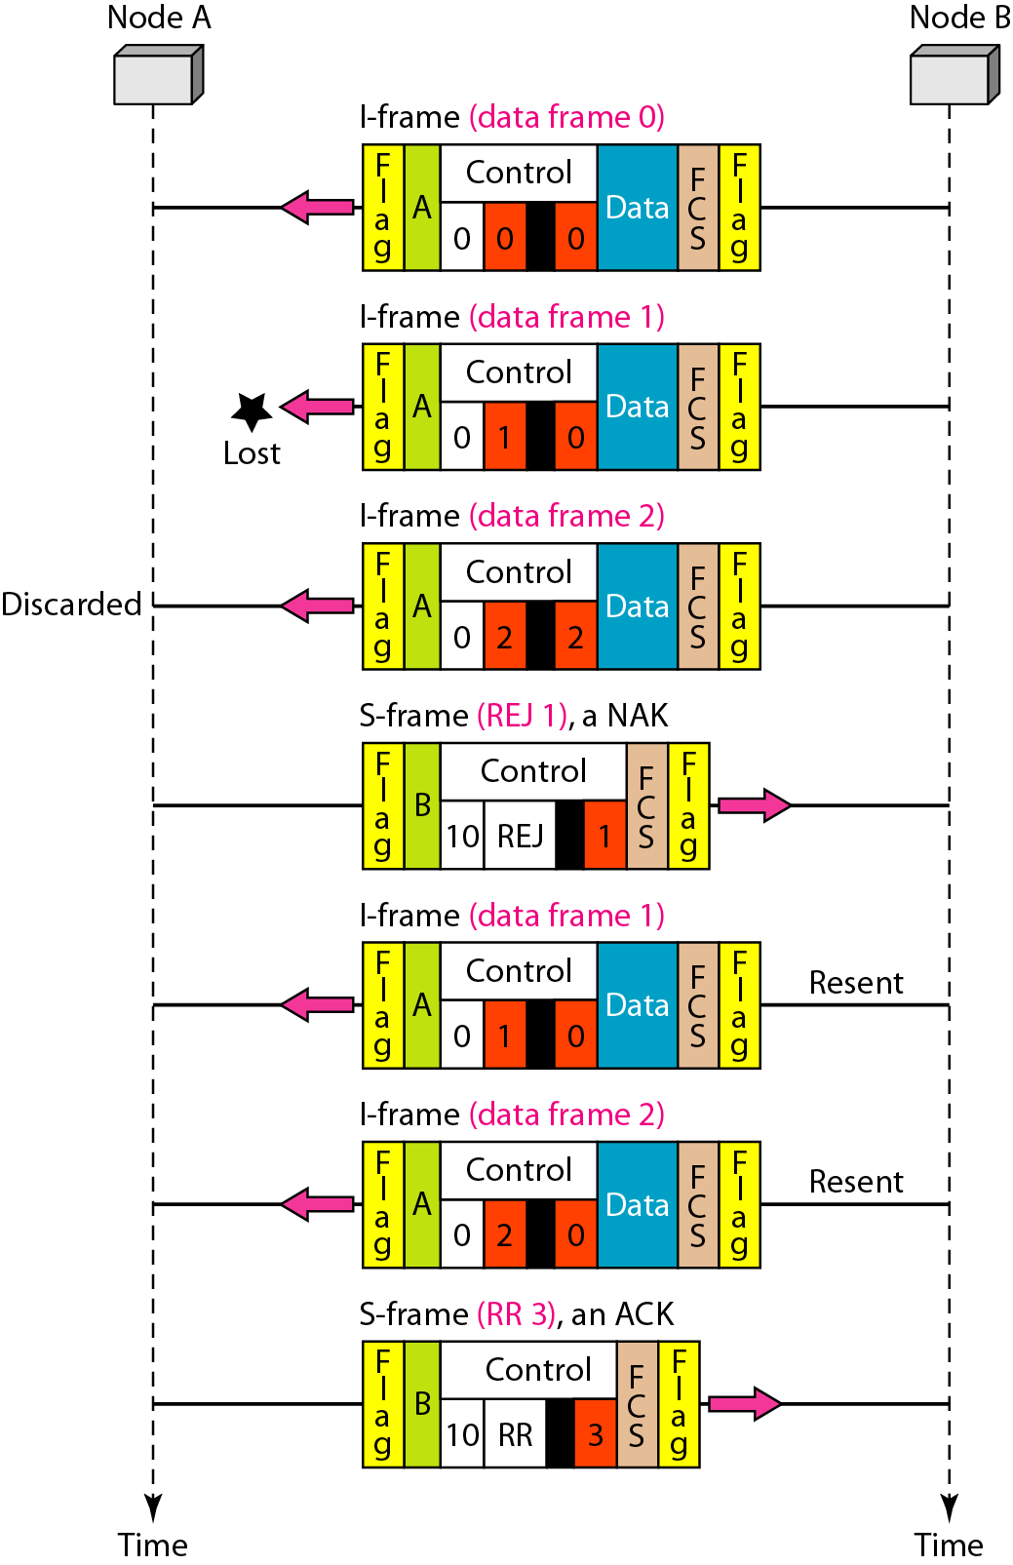
Figure 11.31 Example of piggybacking with error

Slide 95
POINT-TO-POINT PROTOCOL
Although HDLC is a general protocol that can be used for both point-to-point and multipoint configurations, one of the most common protocols for point-to-point access is the Point-to-Point Protocol (PPP).
PPP is a byte-oriented protocol.

Slide 96
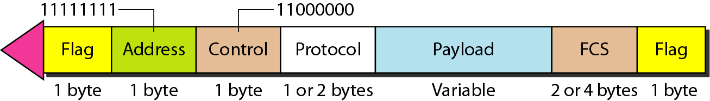
Figure 11.32 PPP frame format
Flag. A PPP frame starts and ends with a 1-byte flag with the bit pattern 01111110.
Address. The address field in this protocol is a constant value and set to 11111111 (broadcast address).
Control. This field is set to the constant value 00000011 (imitating unnumbered frames in HDLC). PPP does not provide any flow control. Error control is also limited to error detection.
Protocol. The protocol field defines what is being carried in the data field: either user data or other information. This field is by default 2 bytes long, but the two parties can agree to use only 1 byte.
Payload field. This field carries either the user data or other information. The data field is a sequence of bytes with the default of a maximum of 1500 bytes; but this can be changed during negotiation. The data field is byte-stuffed if the flag byte pattern appears in this field.
FCS. The frame check sequence (FCS) is simply a 2-byte or 4-byte standard CRC.

Slide 97
Note
PPP is a byte-oriented protocol using byte stuffing with the escape byte 01111101.

Slide 98
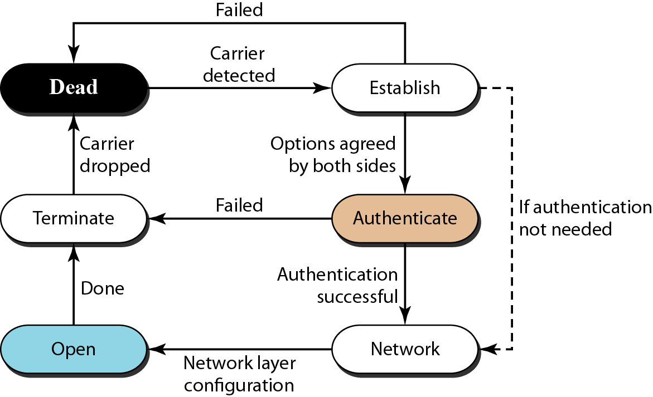
Figure 11.33 Transition phases

Slide 99
Although PPP is a link-layer protocol, it uses another set of protocols to establish the link, authenticate the parties involved, and carry the network-layer data.
Three sets of protocols are defined to make PPP powerful: the Link Control Protocol (LCP), two Authentication Protocols (APs), and several Network Control Protocols (NCPs).
At any moment, a PPP packet can carry data from one of these protocols in its data field, as shown in Figure 11.22.
Note that there are one LCP, two APs, and several NCPs. Data may also come from several different network layers.

Slide 100
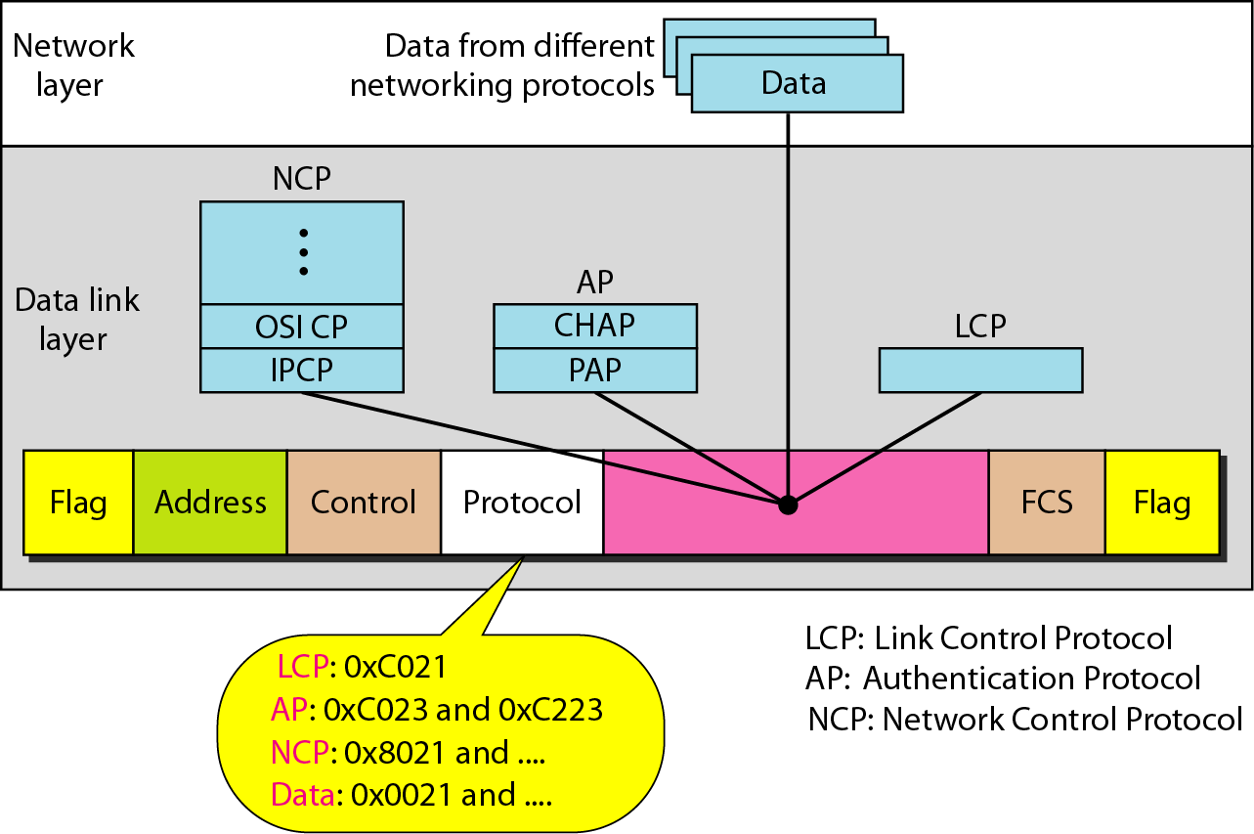
Figure 11.34 Multiplexing in PPP

Slide 101
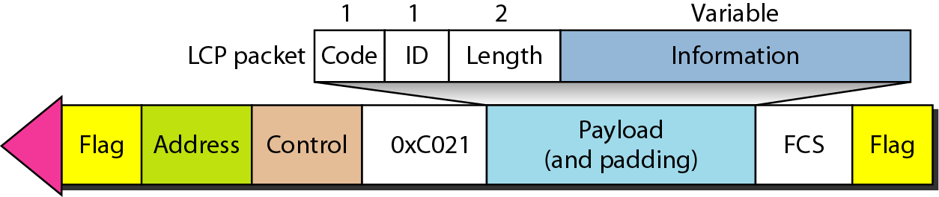
Figure 11.35 LCP packet encapsulated in a frame

Slide 102
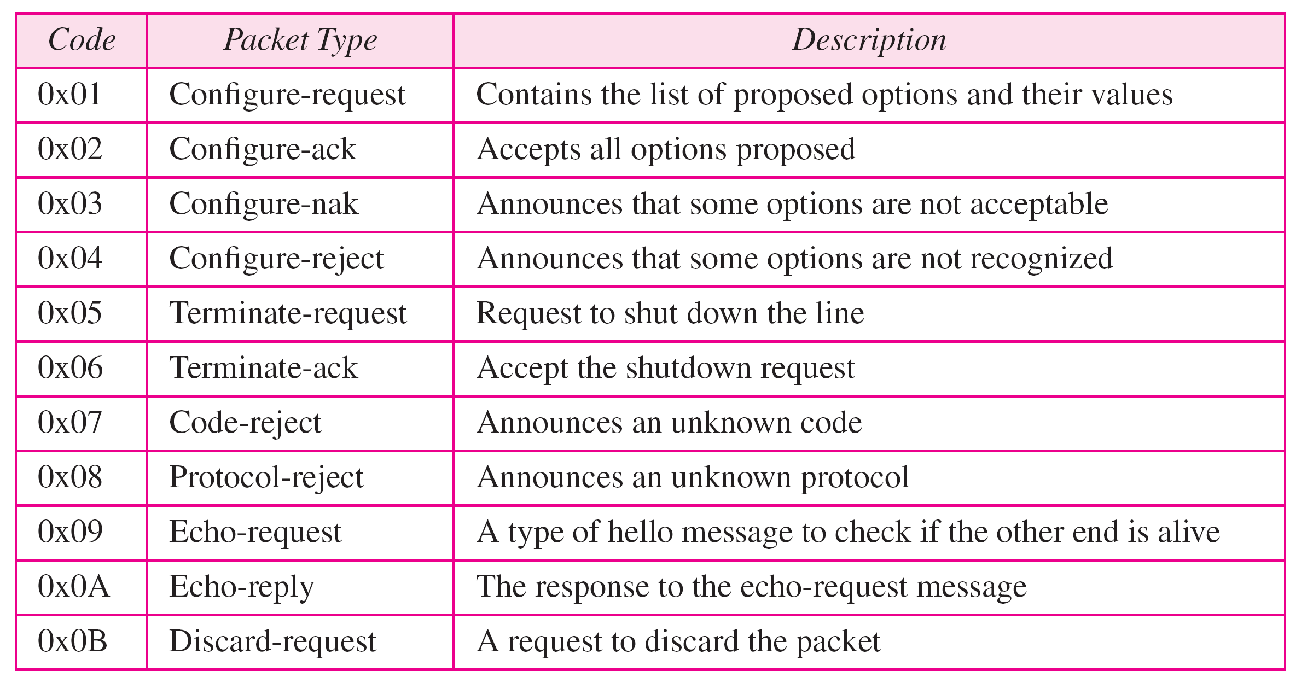
Table 11.2 LCP packets

Slide 103
Table 11.3 Common options

Slide 104
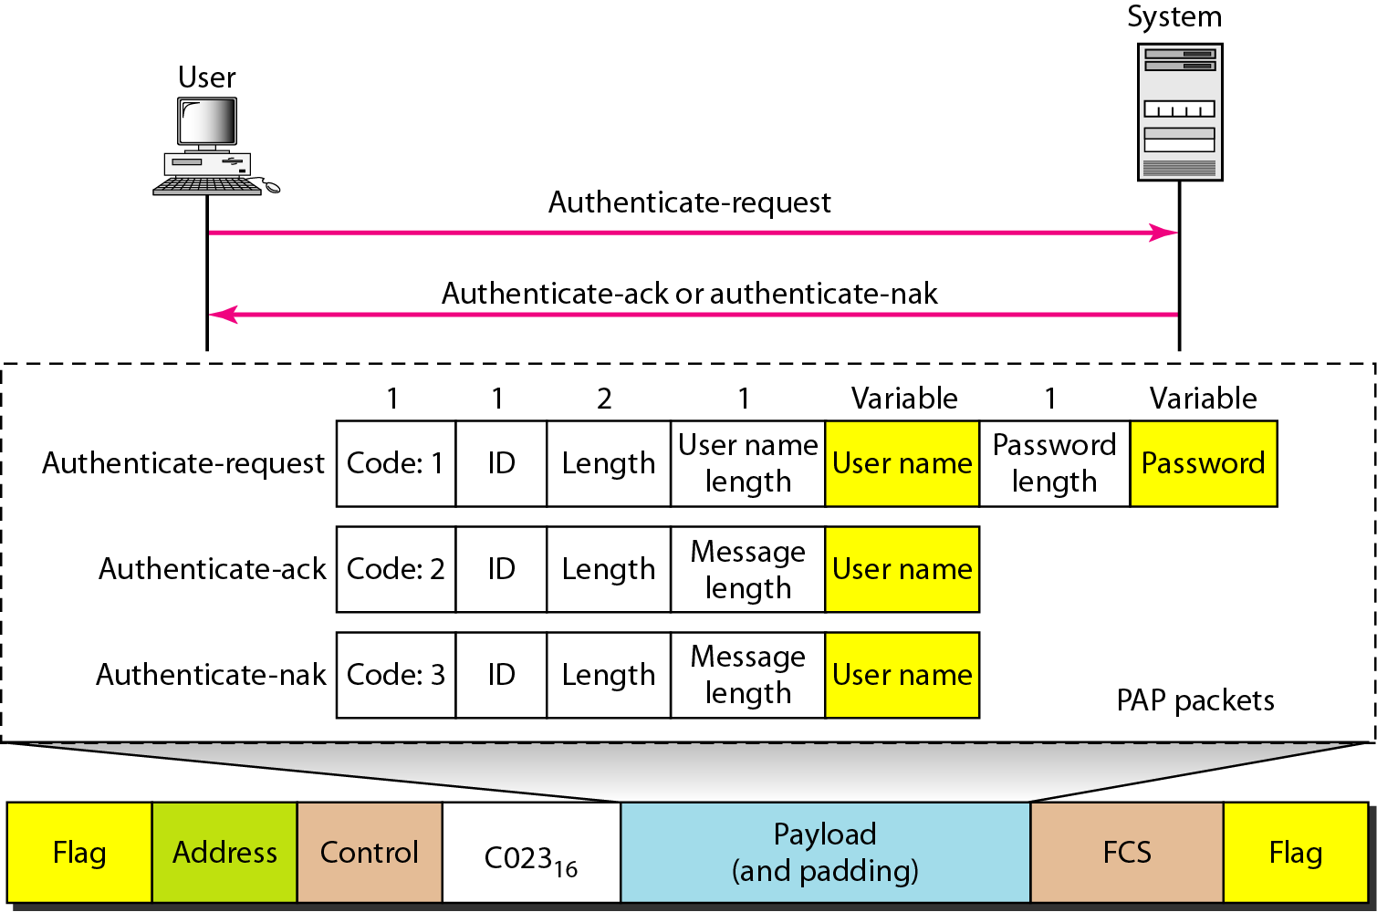
Figure 11.36 PAP packets encapsulated in a PPP frame

Slide 105
PAP
The Password Authentication Protocol (PAP) is a simple authentication procedure with a two-step process:
1. The user who wants to access a system sends an authentication identification (usually the user name) and a password.
2. The system checks the validity of the identification and password and either accepts or denies connection.
Figure 11.24 shows the three types of packets used by PAP and how they are actually exchanged.
When a PPP frame is carrying any PAP packets, the value of the protocol field is 0xC023.
The three PAP packets are authenticate-request, authenticate-ack, and authenticate-nak.
The first packet is used by the user to send the user name and password.
The second is used by the system to allow access.
The third is used by the system to deny access.

Slide 106
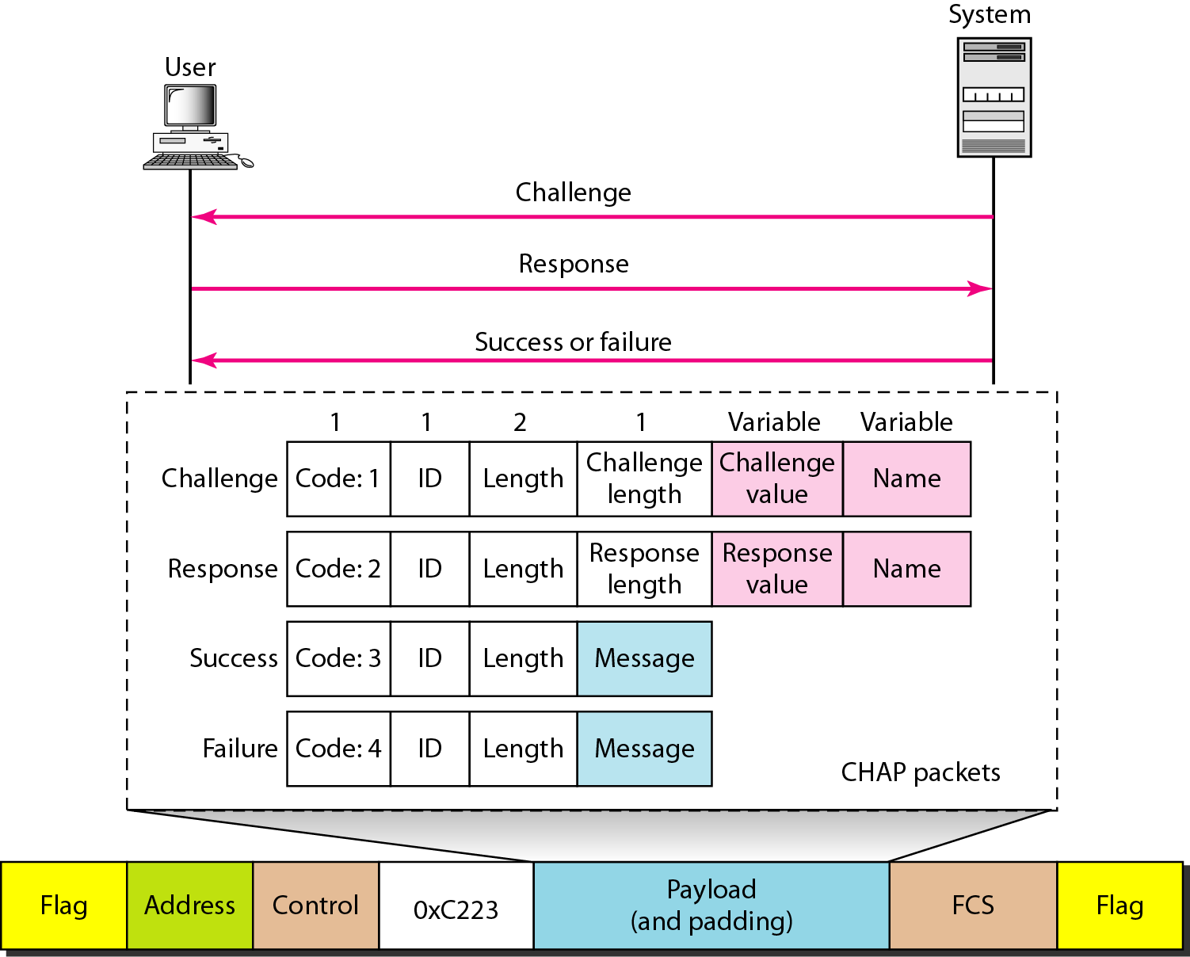
Figure 11.37 CHAP packets encapsulated in a PPP frame

Slide 107
CHAP
The Challenge Handshake Authentication Protocol (CHAP) is a three-way handshaking authentication protocol that provides greater security than PAP. In this method, the password is kept secret; it is never sent online.
1. The system sends the user a challenge packet containing a challenge value, usually a few bytes.
2. The user applies a predefined function that takes the challenge value and the user’s own password and creates a result. The user sends the result in the response packet to the system.
3. The system does the same. It applies the same function to the password of the user (known to the system) and the challenge value to create a result.
If the result created is the same as the result sent in the response packet, access is granted; otherwise, it is denied.
CHAP is more secure than PAP, especially if the system continuously changes the challenge value.
Even if the intruder learns the challenge value and the result, the password is still secret.

Slide 108
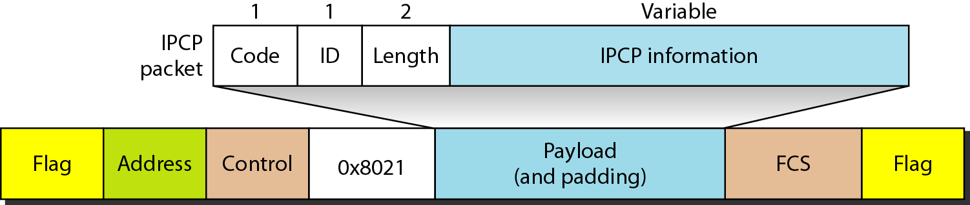
Figure 11.38 IPCP packet encapsulated in PPP frame

Slide 109
IPCP
One NCP protocol is the Internet Protocol Control Protocol (IPCP).
This protocol configures the link used to carry IP packets in the Internet.
IPCP is especially of interest to us.
The format of an IPCP packet is shown in Figure 11.38.
Note that the value of the protocol field in hexadecimal is 8021.
IPCP defines seven packets, distinguished by their code values, as shown in Table 11.4.

Slide 110
Table 11.4 Code value for IPCP packets

Slide 111
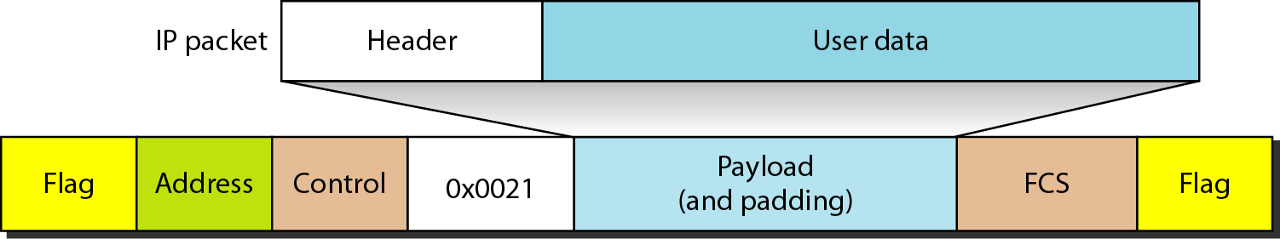
Figure 11.39 IP datagram encapsulated in a PPP frame

Slide 112
Example 11.12
Let us go through the phases followed by a network layer packet as it is transmitted through a PPP connection.
Figure 11.41 shows the steps.
For simplicity, we assume unidirectional movement of data from the user site to the system site (such as sending an e-mail through an ISP).
The first two frames show link establishment.
We have chosen two options (not shown in the figure): using PAP for authentication and suppressing the address control fields.
Frames 3 and 4 are for authentication.
Frames 5 and 6 establish the network layer connection using IPCP.

Slide 113
Example 11.12 (continued)
The next several frames show that some IP packets are encapsulated in the PPP frame.
The system (receiver) may have been running several network layer protocols, but it knows that the incoming data must be delivered to the IP protocol because the NCP protocol used before the data transfer was IPCP.
After data transfer, the user then terminates the data link connection, which is acknowledged by the system.
Of course the user or the system could have chosen to terminate the network layer IPCP and keep the data link layer running if it wanted to run another NCP protocol.

Slide 114

Figure 11.41 An example

Slide 115

Figure 11.41 An example (continued)

Slide 116
What have we completed?
Thank You
Framing
Byte stuffing & Bit stuffing
Flow Control
Error Control
Simplest Protocol
Stop-and-Wait Protocol
Stop-and-Wait Automatic Repeat Request
Go-Back-N Automatic Repeat Request
Selective Repeat Automatic Repeat Request
HDLC
PPP

